Slide 1

Notes:
FabConEurope24 Branded Splash Screen
Slide #1 on all presentations.
The speaker should not edit, move or delete this slide.

Slide 2


Slide 3


FABRIC IN A DAY
FROM ZERO TO HERO
WILL CRAYGER
OWNER & LEAD ARCHITECT, LUCID BI, UNITED STATES
Notes:
Presentation Title Slide
Please input your presentation title, your name, title, company name and country.

Slide 4
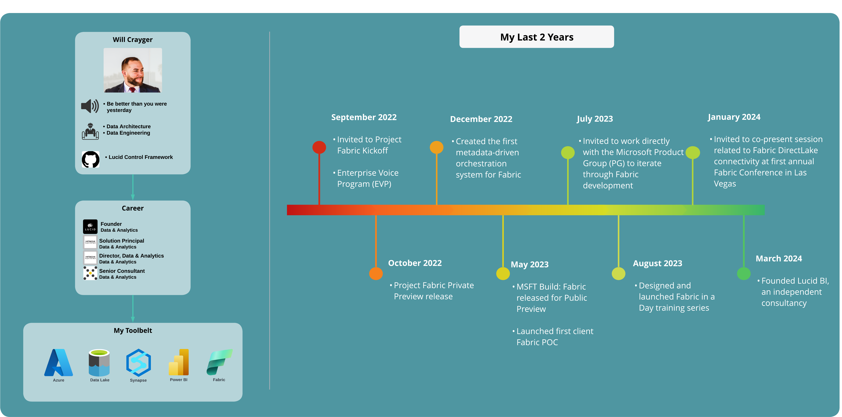

Slide 5
FABRIC IN A DAY: MORNING AGENDA
9:00 – 9:30 AM – Fabric Overview
Intro to Fabric
What is OneLake
Fabric Capacity Overview
Capacity and Licensing Cost
9:30 – 10:15 AM – Working with the Lakehouse
Lakehouse Architecture and Design
Overview of SQL Endpoints
Creating your first Lakehouse
Load data to your Lakehouse
Complete Lab 1
10:30 – 11:00 AM – Morning Break
11:00 – 11:50 AM – Transforming Data with Dataflows gen2
Understanding Dataflows
Navigating Power Query
Complete Lab 2
11:50 – 12:45 PM – Data Orchestration with Pipelines
Understanding pipelines
Intro to parameterization
Using the Copy Data Tool
Complete Lab 3
12:45 – 2:00 pm – Lunch

Slide 6
FABRIC IN A DAY: AFTERNOON AGENDA
2:00 – 2:50 PM – Intro to Spark and Notebooks
Understanding Spark and how Notebooks are used
Overview of Spark configuration in Fabric
Import and execute a Notebook in Fabric
Complete Lab 4
2:50 – 3:15 PM – Working with the Warehouse
Overview of Fabric warehouse
Warehouse loading patterns
3:15 – 3:45 PM – Afternoon Break
3:45 – 4:15 PM – Working with the Warehouse Continued
Complete Lab 5
4:15 – 4:45 PM – Analyzing and Visualizing Data
Building your first semantic model and reports
Complete Lab 6
4:45 – 5:00 PM – Wrap up and final questions

Slide 7
END-TO-END ANALYTICS
WITH FABRIC
Notes:
Section Break Slide
Use this slide for starting a new section of the presentation.
Input the name of the section in the text field.

Slide 8
TODAY’S DATA READINESS
3
Data Governance
What data do I have?
2
Is it trustworthy?
Analytics
Can people access the data needed to make the right decisions?
1
Operational Databases
Operational databases
How can I enable faster business insights?
What’s my compliance exposure?

Slide 9
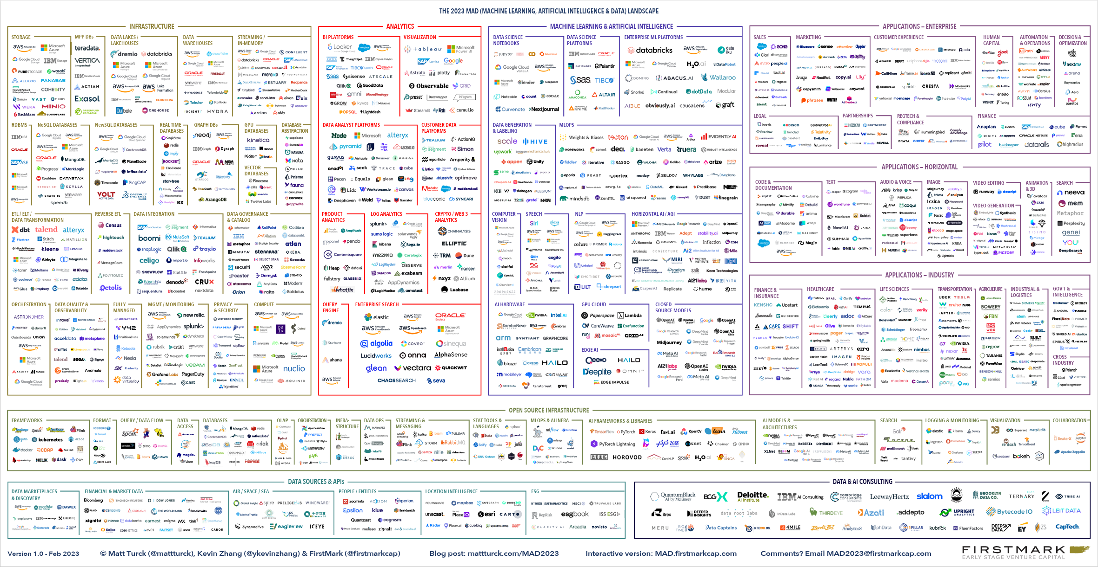
FRAGMENTATION OF THE MODERN DATA STACK
2023 ML, AI, and Data Landscape

Slide 10
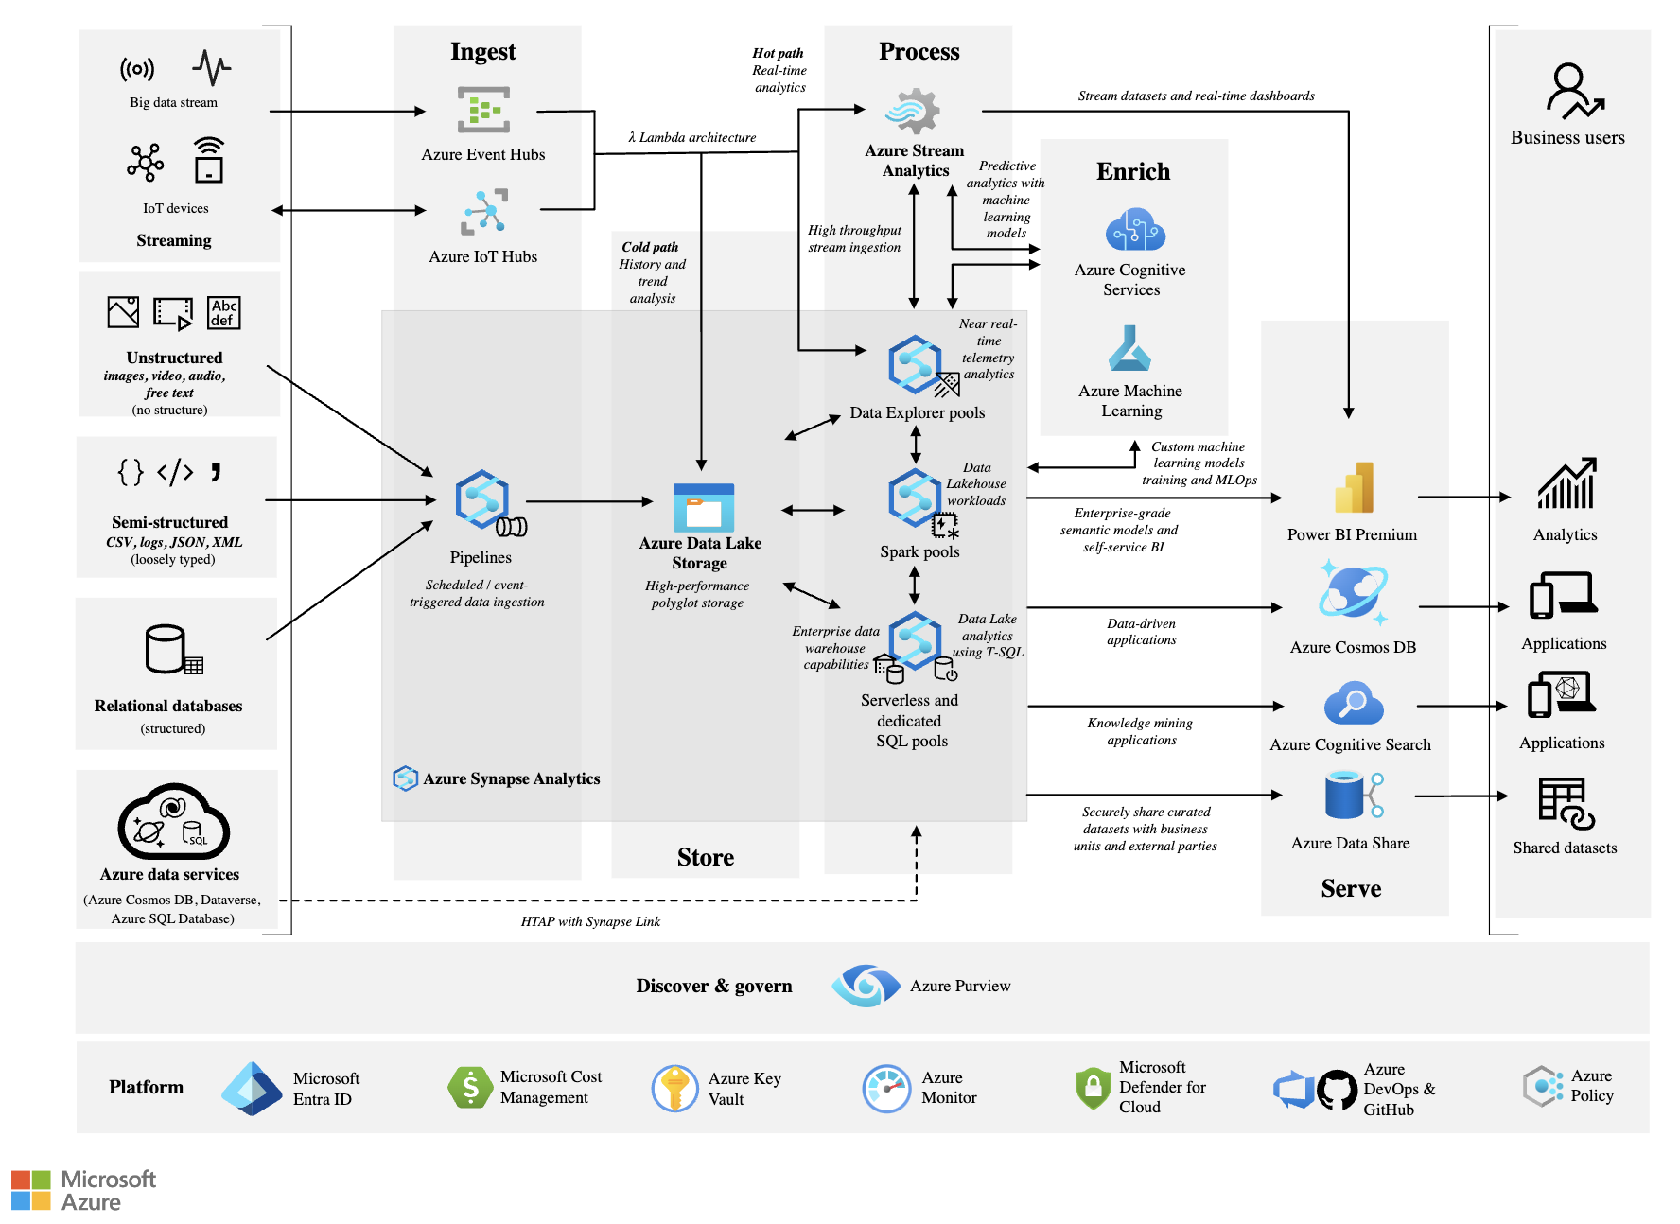
SCALABLE ANALYTICS ARE COMPLEX & FRAGMENTED
Every analytics project has many subsystems
Products often come from multiple vendors
Integration at scale across products is complex, fragile and expensive

Slide 11







EXISTING MICROSOFT ANALYTICS SUITE
Many Products
Different Experiences
Purview
Proprietary and Open
Azure AI
Dedicated and Serverless
Power BI
PaaS and SaaS
Synapse DW
Different Business Models
Kusto
Steep Learning Curves
Synapse Spark
Deep Expertise Needed
Data Factory
High Integration Effort

Slide 12








THE EVOLUTION OF MICROSOFT ANALYTICS SUITE: MICROSOFT FABRIC
Data Integration
Data Lake
Data
Engineering
Data
Warehouse
Real Time Analytics
Data
Science
Business
Intelligence
Governance
Unified analytics fabric
End-to-end analytics platform

Slide 13
INTRODUCTION TO ONELAKE AND FABRIC CAPACITY
Notes:
Section Break Slide
Use this slide for starting a new section of the presentation.
Input the name of the section in the text field.

Slide 14




INTRODUCTION TO ONELAKE
Lake-centric architecture that offers a unified environment for data professionals and business leaders to work together
Merges storage from various regions and cloud platforms into one logical lake, minimizing data duplication or movement
Just as Office apps are naturally connected to OneDrive, Fabric’s compute engines function with OneLake to read and write data

Slide 15
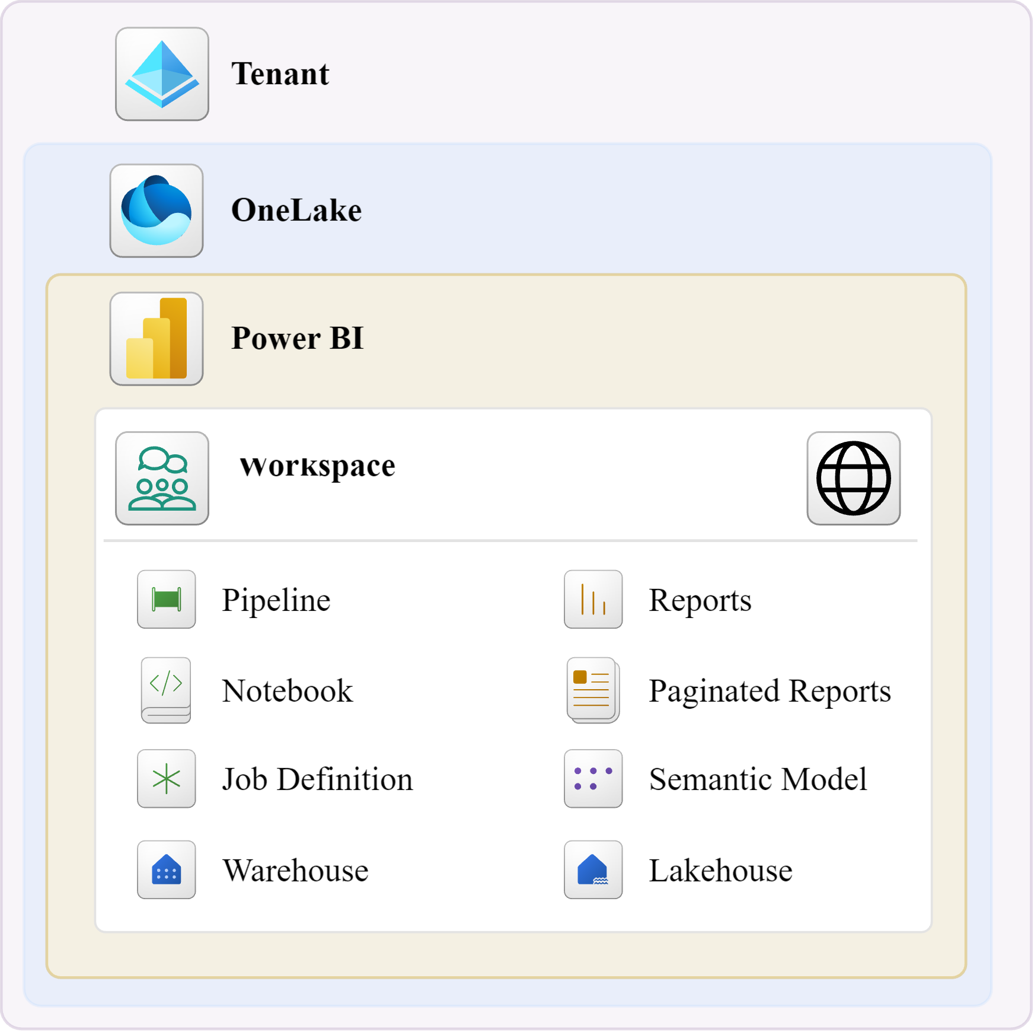
ORGANIZATIONAL STRUCTURE OF ONELAKE
OneLake is tenant-wide, meaning there is only a single OneLake per tenant
Within OneLake, data connectivity across workspaces within the tenant is automatically enabled allowing for cross-workspace workloads
Workspaces can be thought of as folders within OneLake

Slide 16
ONELAKE FOR ALL DOMAINS
Workspaces and artifacts for different data domains, contribute to building the same data lake
OneLake
Sales
Customer
Without data movement, data from different domains can be analyzed, blended and transformed together
HR
IT
Marketing
Data is secured and governed in one place while remaining easily discoverable and accessible to all who should have access across the organization
Finance
Operations
Data can be certified by domain experts to enabling trust for data which is discovered

Slide 17
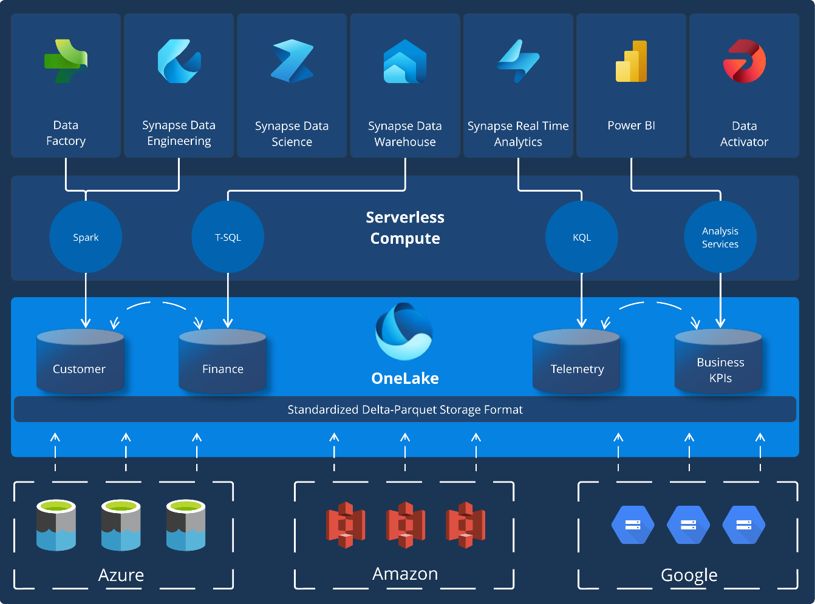
ORGANIZATIONAL STRUCTURE OF ONELAKE
OneLake is constructed on Azure Data Lake Storage (ADLS)
Supports structured and unstructured data formats such as Delta, Parquet, CSV, and JSON
For structured data, Fabric's analytics engines save data in the delta-parquet format, ensuring smooth interaction across all engines

Slide 18
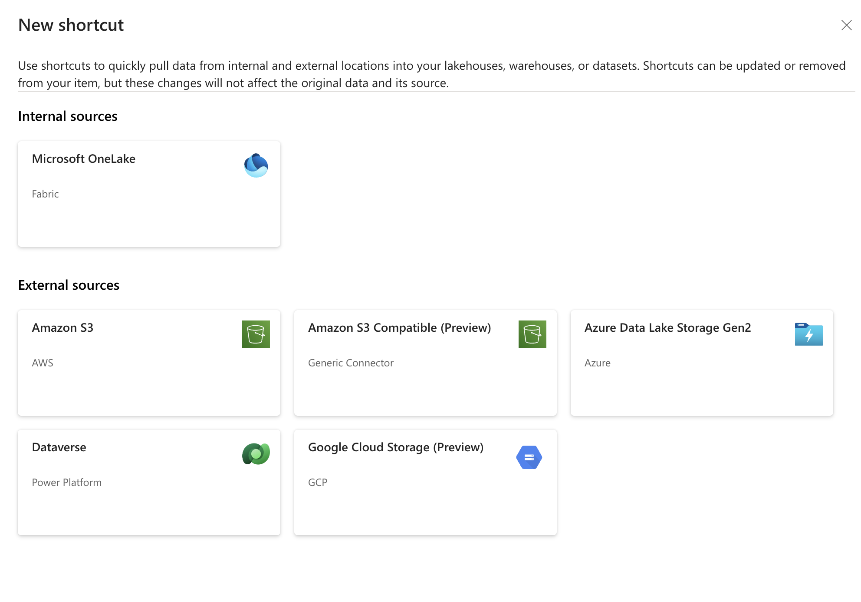
CREATING ONE COPY WITH SHORTCUTS & MIRRORING
With shortcuts, data throughout OneLake can be composed together without requiring data movement
Shortcuts are references (pointers) directing to other files or storage points for data visualization
Shortcuts also support data already in Azure, and other clouds, without creating a copying, making OneLake a multi-cloud data lake
Mirroring provides a low-latency replication option for data from sources such as Azure SQL, Azure Cosmos, and Snowflake database environments

Slide 19
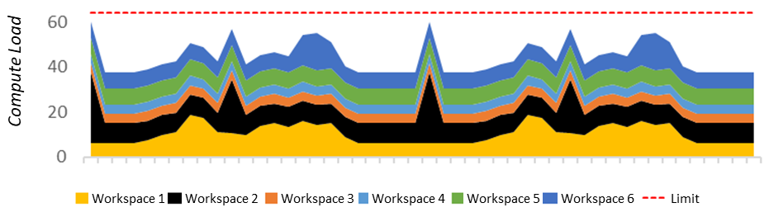

ORGANIZATIONAL STRUCTURE OF ONELAKE
A single capacity is providing the compute power for all the Fabric’s workloads
Data Warehousing
Data Engineering
Data Integration
Data Science
Real Time Analytics
Business Intelligence
A single capacity typically supports dozens of separate projects simultaneously, each managed in its own workspace
Developers will share a workspace where collaborative development and consumption at scale is managed
Developers/Creators
Consumers
Workspace

Slide 20

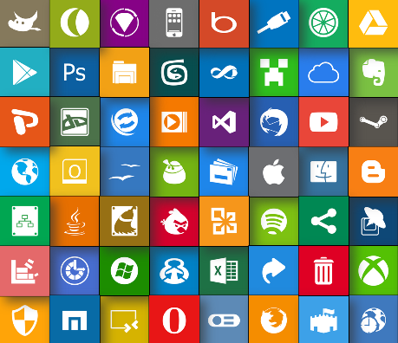
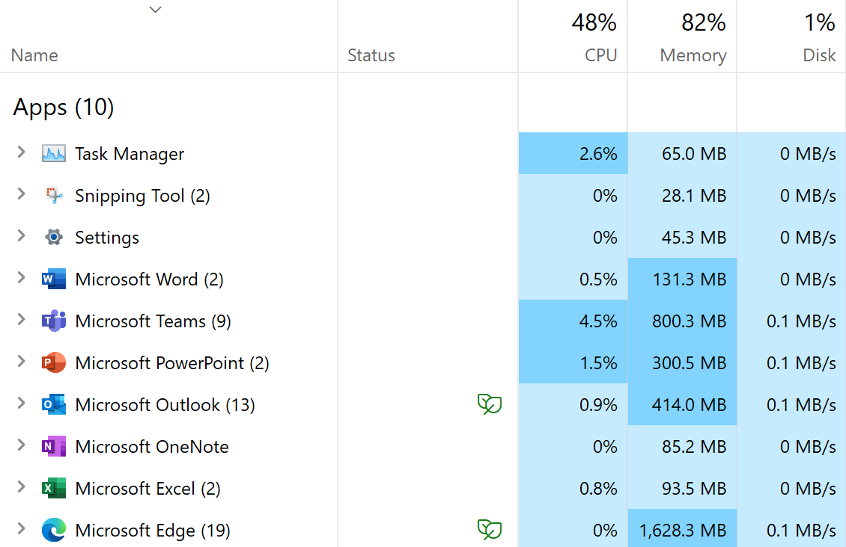
UNDERSTANDING FABRIC COMPUTE CAPACITIES
When you purchase a PC, you choose the number of CPU cores. The more CPU cores the more load the PC can handle.
The CPU cores are dynamically shared across all applications with no need to pre-allocate by app.
The total consumption of the CPU across all apps cannot exceed the number of cores. CPU overload causes throttling.
Personal Computing
Fabric uses Capacities with “capacity units”. More CU’s means heavier compute loads are possible. Capacities can be scaled up/down as needed.
The total consumption of the capacity across all the workloads cannot exceed the capacity units provisioned, or throttling will occur.
The capacity units are dynamically shared across all the Fabric workloads, with no pre-allocation necessary.
Fabric Capacities

Slide 21
CAPACITIES ARE A SAAS RESOURCE
Always On
Auto-pilot
Eliminate Workload Management
Always Peak
Performance
Capacities are a self-managed system that alleviates day-to-day or hour-to-hour resource management by admins.
Providing complete transparency into the usage of the capacities at any grain: projects/workspaces, artifacts, queries, users and jobs
Large jobs can be scheduled at any time without impacting any other jobs running
Smoothing automatically prevents spikey loads from creating temporal overload of the system – thereby you are purchasing for average load vs. max load.
Bursting allows all jobs and queries to always run at peak performance regardless of any other compute activity happening on the capacity
Auto scale can automatically adjust the compute units provisioned to the capacity

Slide 22
FABRIC VS POWER BI PREMIUM CAPACITY
Capacity usage in Fabric is almost identical to capacity usage in Power BI Premium Per Capacity (PPC)
Power BI Pro
Power BI Premium
Microsoft Fabric
(pay-as-you-go)
Microsoft Fabric
(reserved instance)
$10.00 USD
user/month
Access Power BI reports shared with you and publish your own for an even bigger impact.
$4,995 USD
capacity/month (P1)
License for your organization to access Microsoft Fabric
$8,409.60 USD
capacity/month (F64)
License for your organization to access Microsoft Fabric
$5,000 USD
capacity/month (F64)
License for your organization to access Microsoft Fabric
If you currently have PPC, such as P1, you can begin using Fabric today
Publish and share Power BI reports
Included in Microsoft 365 E5 and Office 365 E5
Includes all features from Pro and Premium Per User
Grants access to the rest of the Fabric workloads
Dynamically scale up or down and pause capacity
Microsoft Azure Consumption Commitment (MACC) eligible
Annual purchase, saving 40.5% over pay-as-you-go prices
Microsoft Azure Consumption Commitment eligible
However, with Fabric comes the introduction of a new license type, the F SKU

Slide 23
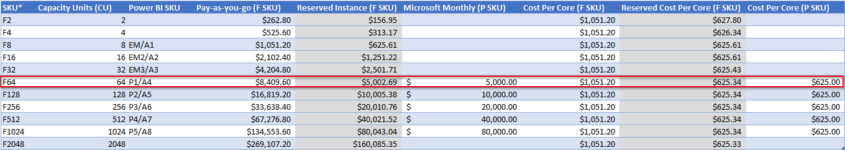
FABRIC VS POWER BI PREMIUM CAPACITY
VS.
Power BI Premium
Microsoft Fabric
License is provisioned through Microsoft Office
The smallest provisioned capacity provides 64 capacity units (CU)
Power BI Premium SKUs cannot be paused but can be scaled through Office
Fabric capacity is provisioned through the Azure Portal
The smallest provisioned capacity provides 2 capacity units (CU)
Fabric capacity can be paused, resumed, and scaled via Azure portal

Slide 24
WORKING WITH THE FABRIC LAKEHOUSE

Slide 25
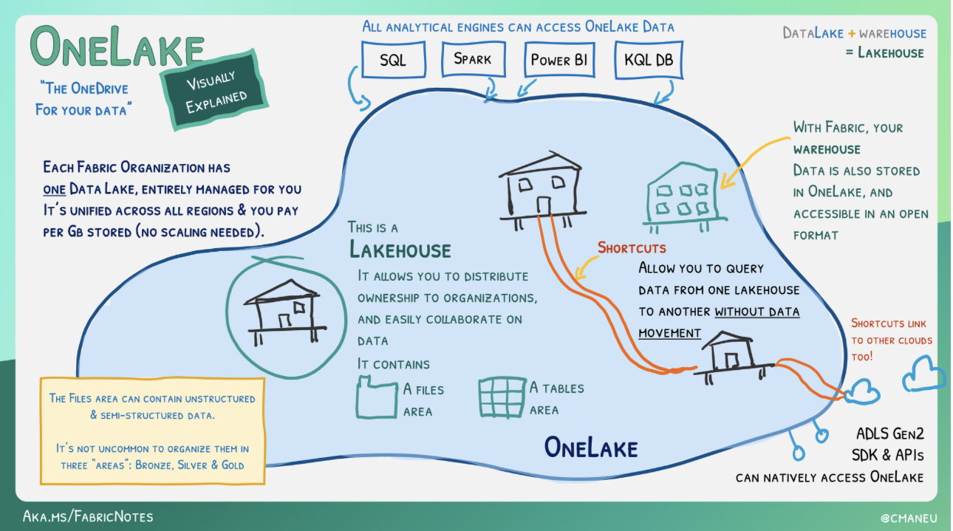
OVERVIEW OF A LAKEHOUSE
Data platform designed to store, manage, and analyze both structured and unstructured data
Appears as a database built on a data lake using Delta tables
Merges SQL-based analytics of a data warehouse with a data lake's scalability and flexibility
Stores all data formats and can be used with various analytics tools as well as programming languages

Slide 26
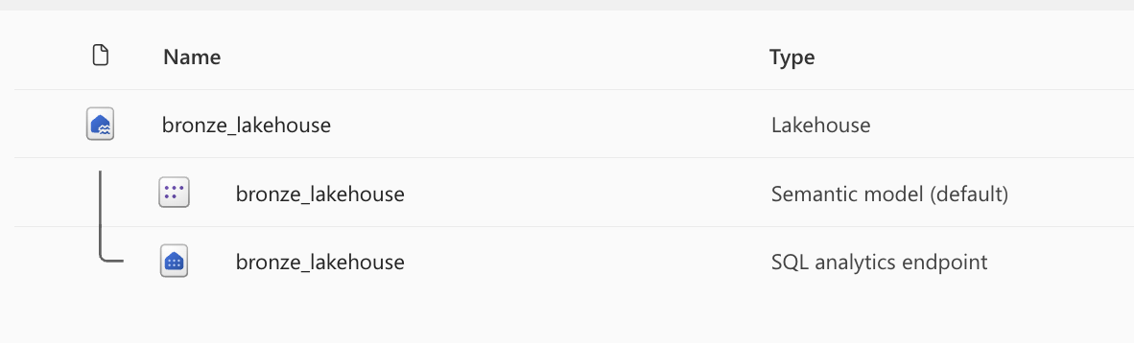
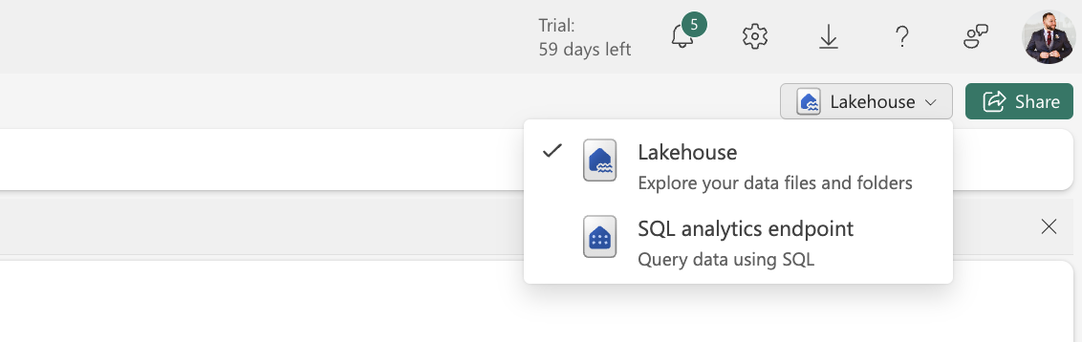
SETTING UP AND NAVIGATING THE LAKEHOUSE
Each Lakehouse in a Fabric-enabled workspace consists of three main elements:
Lakehouse: Storage and metadata section used to engage files, folders, and tables
Semantic Model (default): Auto-generated data model derived from the tables in the Lakehouse
SQL Analytics Endpoint: Provides a read-only SQL interface, allowing users to connect and query data using T-SQL

Slide 27
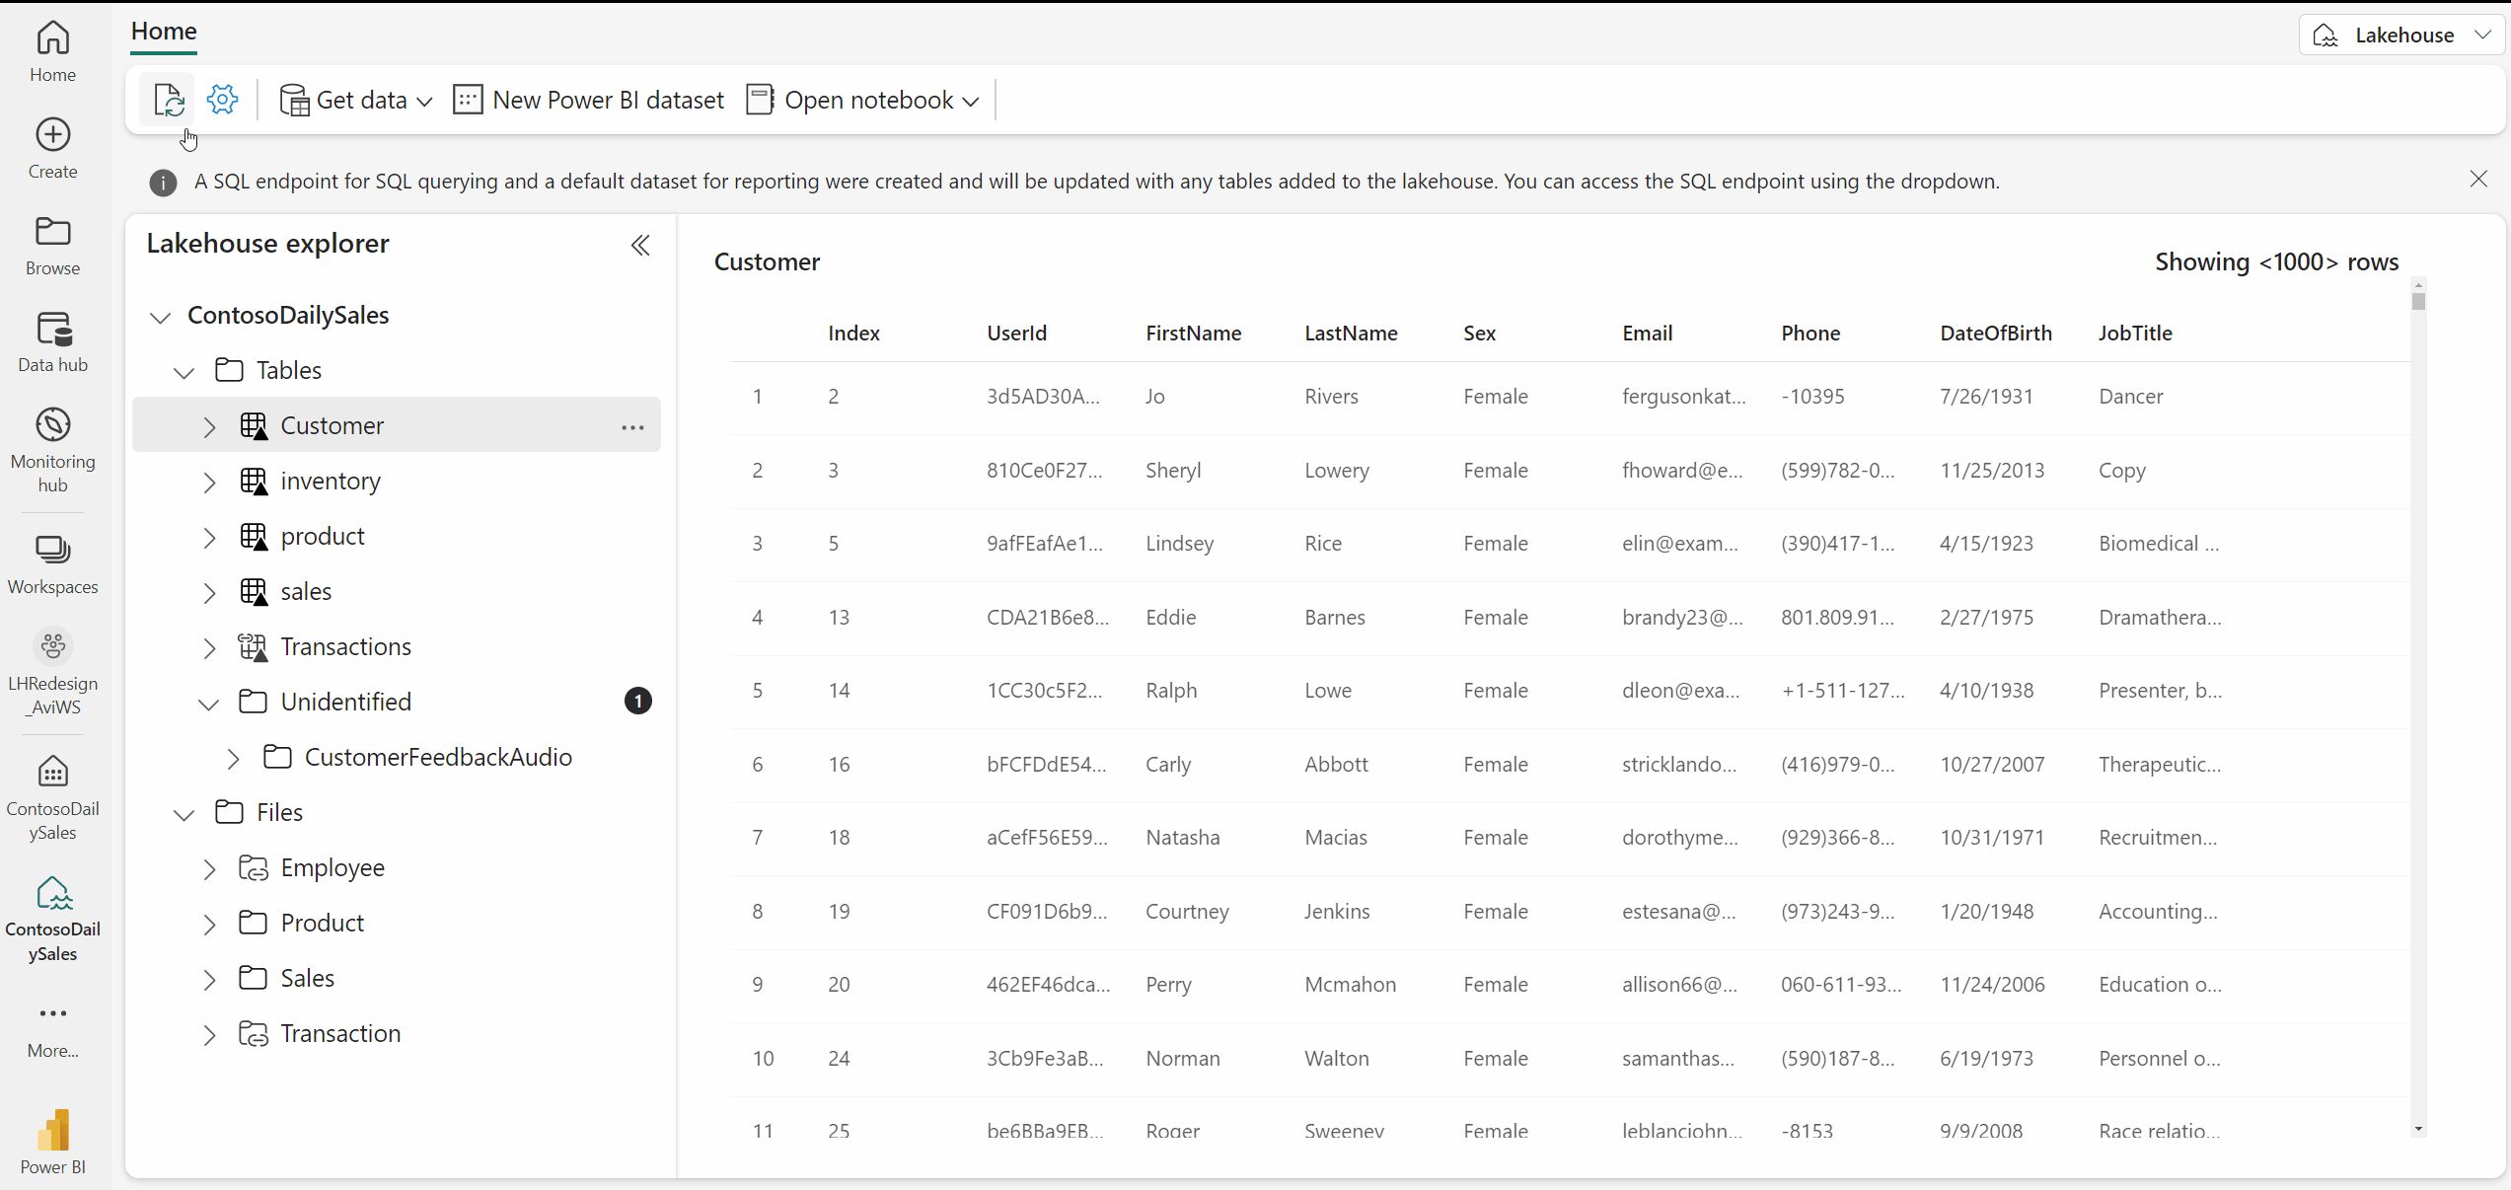
USING THE LAKEHOUSE EXPLORER
Allows for loading, browsing, and previewing data elements within the Lakehouse
Lakehouse Explorer: Provides a preview of tables and files in the lakehouse
Ribbon: Enables creation of notebooks and semantic models as well as the capture new data using shortcuts, dataflow gen2, pipelines, and event streams

Slide 28
TRANSFORMING AND ANALYZING DATA IN FABRIC LAKEHOUSE

Slide 29
LOADING PATTERNS WITH LAKEHOUSE
1
2
3
4
Directly upload local files or folders to the Lakehouse
Utilize Power Query Online with Dataflows (Gen2) to import and transform data from various sources, providing a visual transformation representation
Use Data Factory Pipelines to copy data and coordinate data processing tasks such as orchestrating Spark, Dataflows, and other control flow logic
Establish connections to external storage solutions, such as OneLake, Azure Data Lake Store Gen2, Amazon S3 and S3 compatible sources for seamless integration into your Lakehouse

Slide 30
TRANSFORMATION PATTERNS WITH LAKEHOUSE
Every Fabric lakehouse is equipped to utilize Spark pools for data processing in files and tables using Scala, PySpark, or Spark SQL
Developers can use interactive Notebooks to directly read from, transform, and write data to the lakehouse in the form of tables or files
On-demand or scheduled Spark Job Definitions can also employ the Spark engine for data processing within the lakehouse
Read-only SQL analytics endpoints allow you to execute T-SQL commands to query, filter, aggregate, and explore data stored in the lakehouse tables

Slide 31



GUIDED LEARNING LABS 1
Provisioning a Lakehouse
Upload CSV data file, create a managed table
Exploring Lakehouse, SQL Endpoint, and Dataset

Slide 32
PREPARING DATA WITH DATAFLOWS GEN2

Slide 33
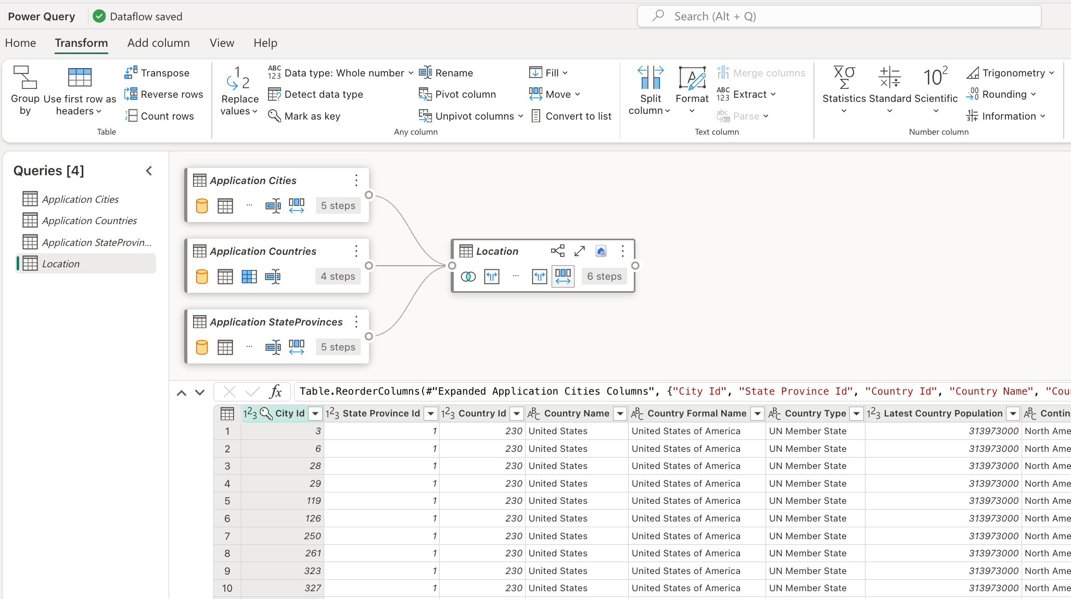
FABRIC DATAFLOWS GEN2
Cloud-based, Power Query, data prep tool for extracting, transforming, and loading
Currently has native support for over 145 source connectors, significantly more than pipelines
Includes all standard Power Query transformations as well as support for destinations providing similar functionality to pipelines

Slide 34
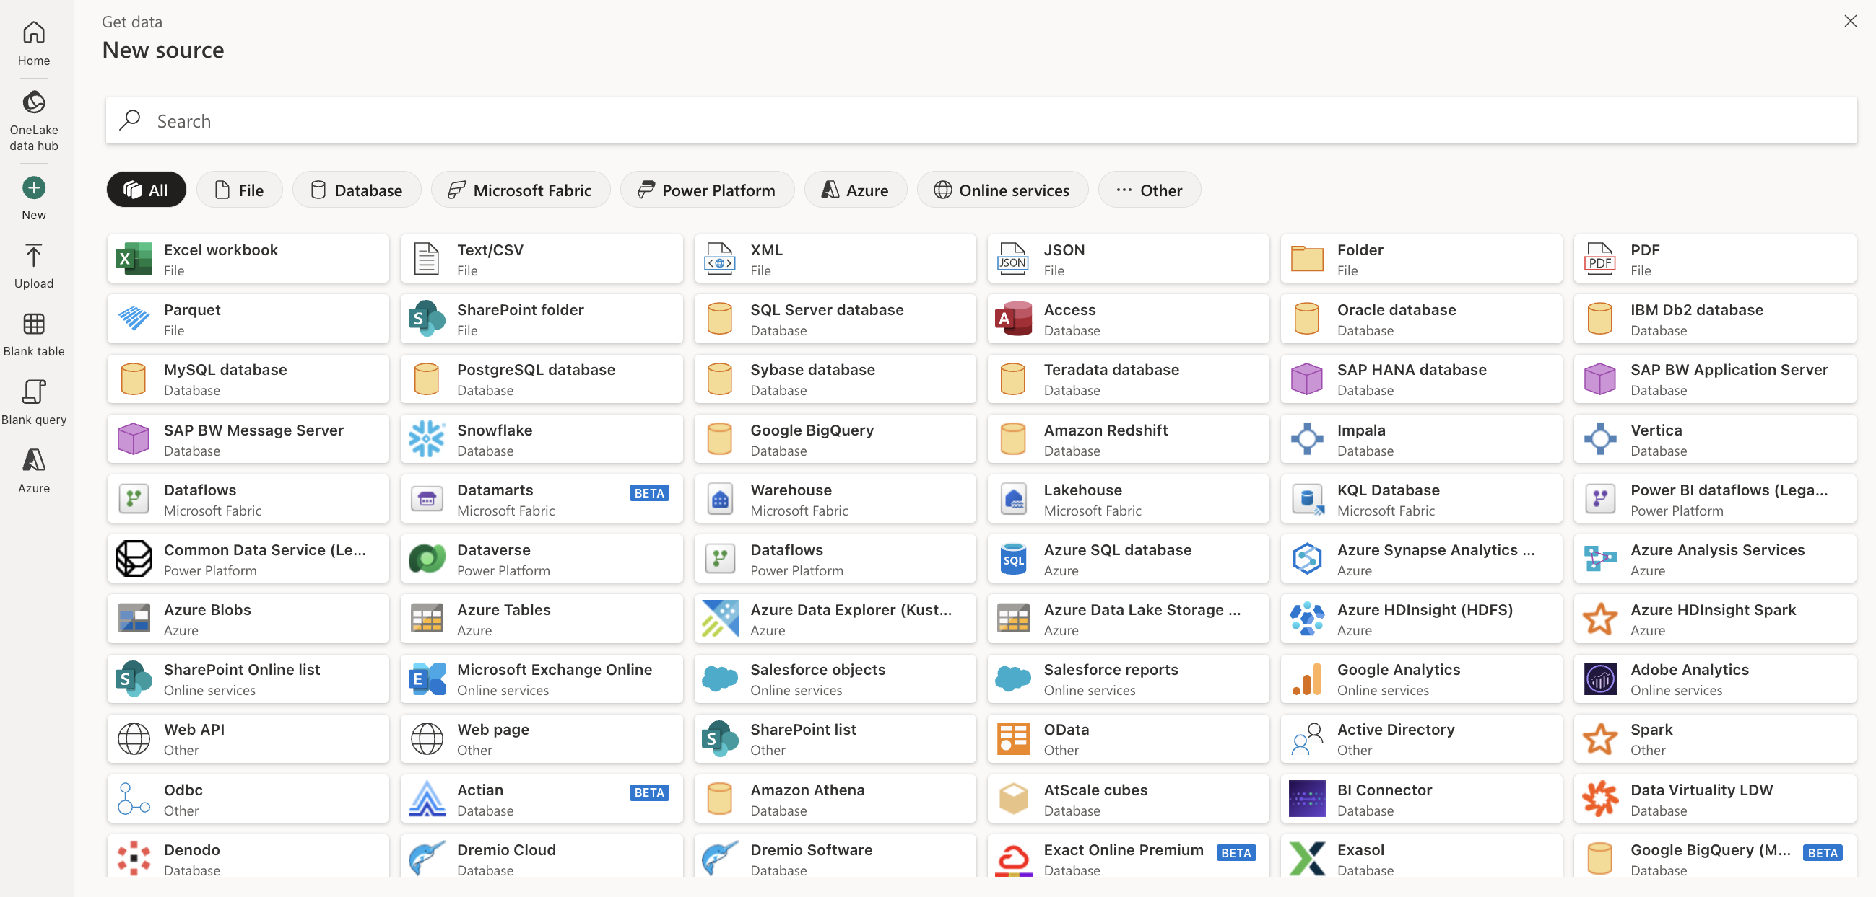
COMMON SOURCE & DESTINATION CONNECTORS
SQL Server
Oracle
SAP BW / SAP HANA
Azure Synapse
Azure Databricks
Data Lake Store gen2 and Azure Blobs
SharePoint
Salesforce
Google Analytics
Profisee
Fabric Lakehouse
Fabric Warehouse
Fabric KQL database

Slide 35
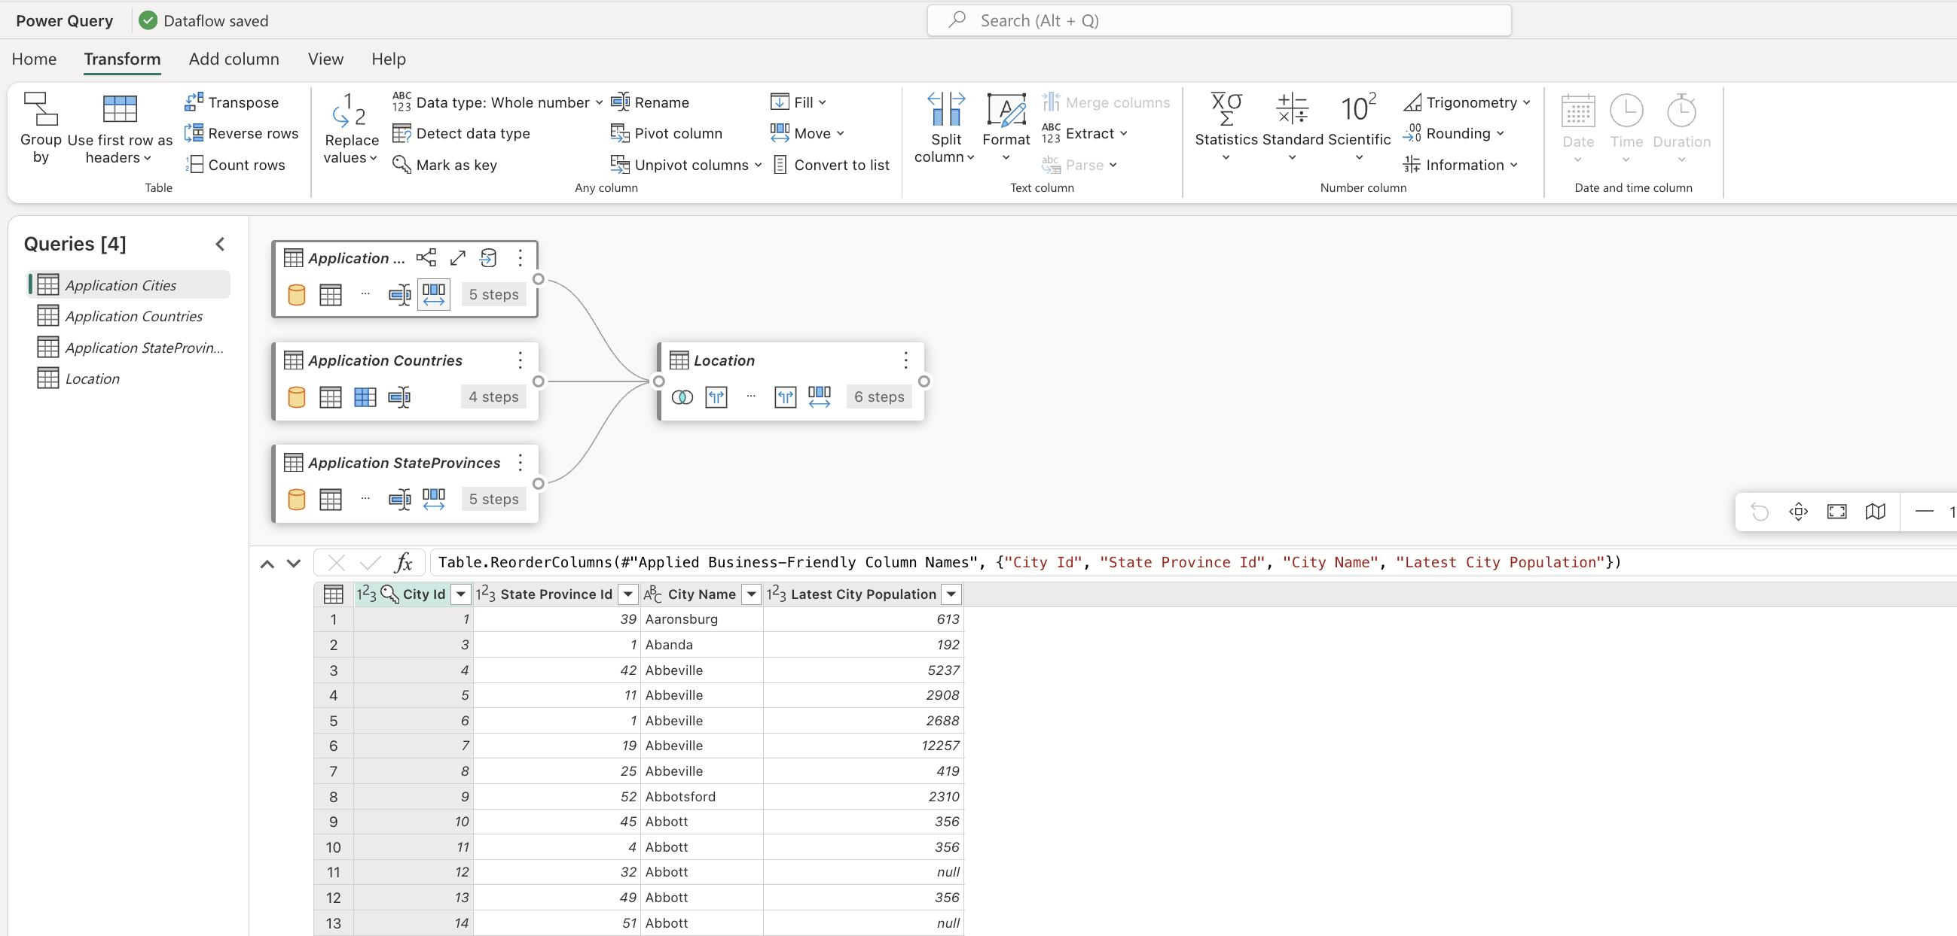
COMMON TRANSFORMATION TASKS
Filtering and sorting rows
Pivoting and unpivoting
Merging and appending queries
Splitting and conditional splits
Replacing values and removing duplicates
Managing columns (adding, renaming, reordering, deleting)
Ranking
Write to destination

Slide 36
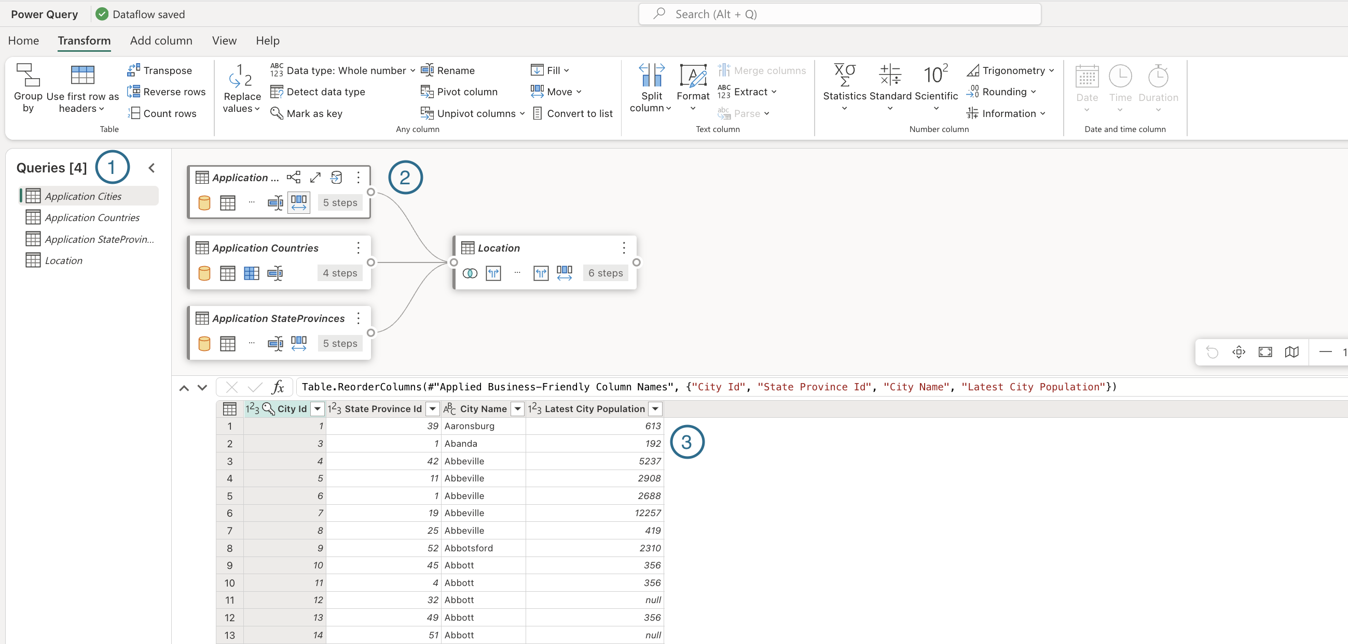
QUERIES PANE, DIAGRAM VIEW, DATA PREVIEW PANE
Queries Pane:
Displays different data sources, referred to as queries
Offers options like renaming, duplicating, referencing, and enabling load
Diagram View
Provides a visual representation of how data sources relate, and the transformations applied
Data Preview Pane
Showcases a subset of data, allowing users to identify necessary transformations and their impacts
Allows for drag-and-drop interaction

Slide 37
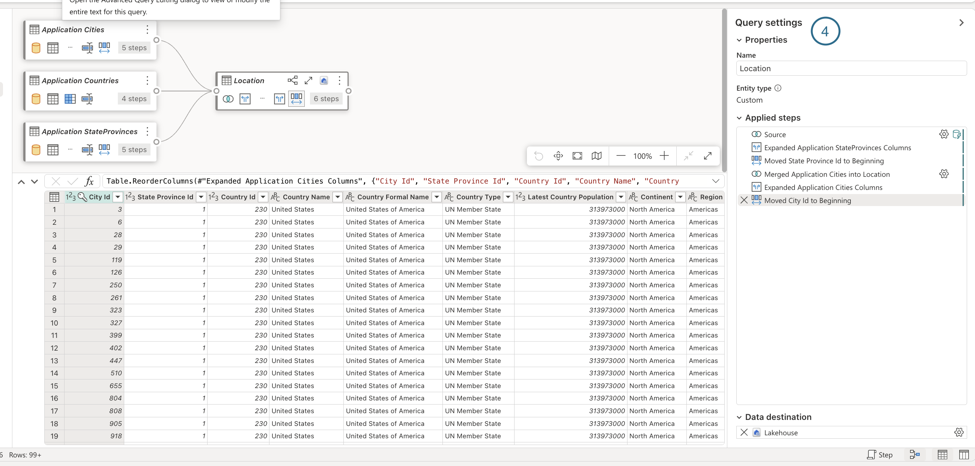
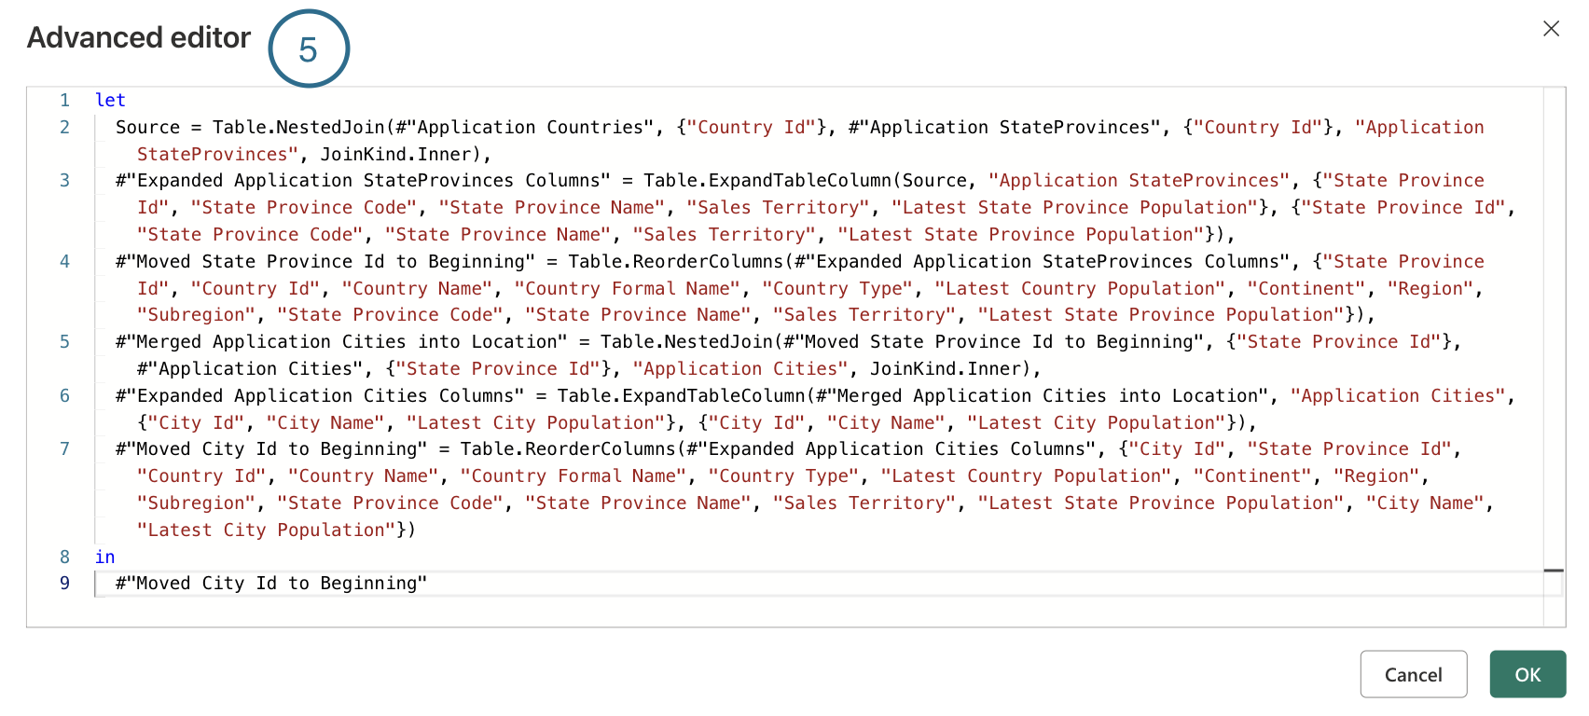
QUERY SETTINGS PANE
Queries Settings:
Each transformation corresponds to a step
Numerous steps might be associated with each query
Optional Data Destination tab, unique to dataflows gen2
Advanced Editor:
Displays the M code being produced from each applied step
Interface where M code can be directly written/applied

Slide 38
DATAFLOW GEN2 BENEFITS AND CONSIDERATIONS
Benefits:
Allows data to be extracted from source once and can be reused
Simplifies data integration with a low-code interface
Ensures data consistency and quality by enabling pre-load data cleansing and transformation
Has a Fast Copy mode to address performance limitations during data extraction
Can be integrated into Fabric pipeline workloads
Considerations:
Performance of the Power Query engine can degrade as dataset size increases causing a bottleneck in workloads
Fast Copy mode has several limitations including source type, file format, transformations being applied, and whether a gateway is required

Slide 39


GUIDED LEARNING LAB 2
Create Dataflow (Gen2)
Build flow in PowerQuery to pull data from source and move to Lakehouse

Slide 40
DATA ORCHESTRATION WITH DATA PIPELINES

Slide 41
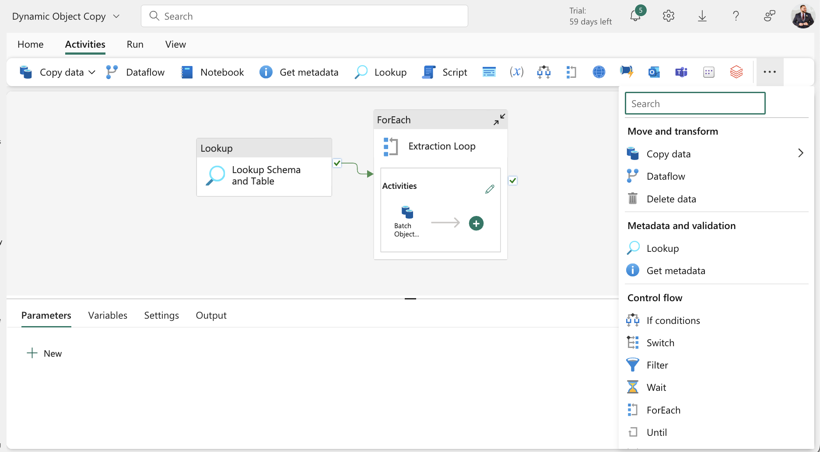
UNDERSTANDING FABRIC PIPELINES
Data pipelines orchestrate and automate ETL/ELT processes using pipeline activities
Extracting data from sources
Triggering transformation activities
Writing data to a destination
Leverages the same architecture as Azure Data Factory and Synapse integration pipelines
Uses Connections instead of a Linked Service
Currently has only a subset of source connectors
Optimal for working with large datasets

Slide 42
PIPELINE ORGANIZATION AND STRUCTURE
Pipeline canvas serves as the primary element for building workflows of single or multiple activities
Orchestration and processing is completed using pipeline activities, which can be combined to define activity dependencies
Parameters and variables can be used to create dynamic orchestration patterns

Slide 43
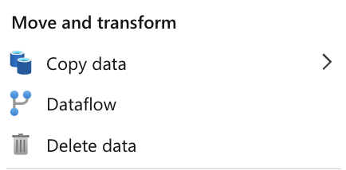
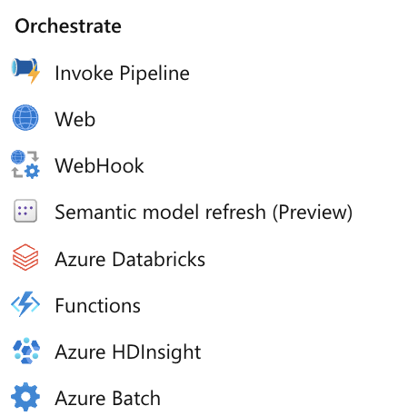
PRIMARY ACTIVITY TYPES
Move and Transform:
Pipelines are considered orchestration and movement items rather than transformation items
Orchestrate:
Often the primary choice for conducting multiple tasks in a particular order such as extracting data with a copy task, using a Databricks activity to transform, and refreshing the semantic model for consumption

Slide 44
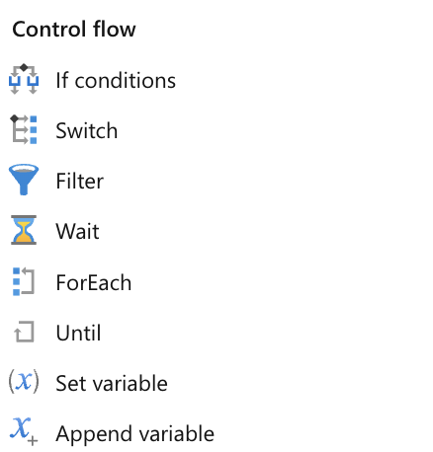
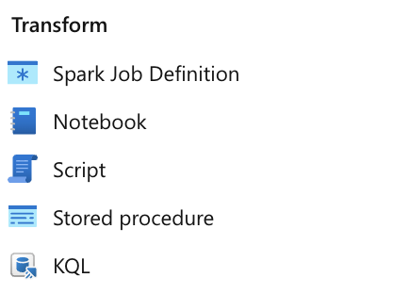
PRIMARY ACTIVITY TYPES
Control Flow:
Dynamic patterns leverage iterators like ForEach and conditionals like If and Switch
Transform:
References to transforming data in the context of a pipeline often refer to orchestration engaging a notebook, stored procedure, or equivalent script – the pipeline does not perform the transformation natively

Slide 45
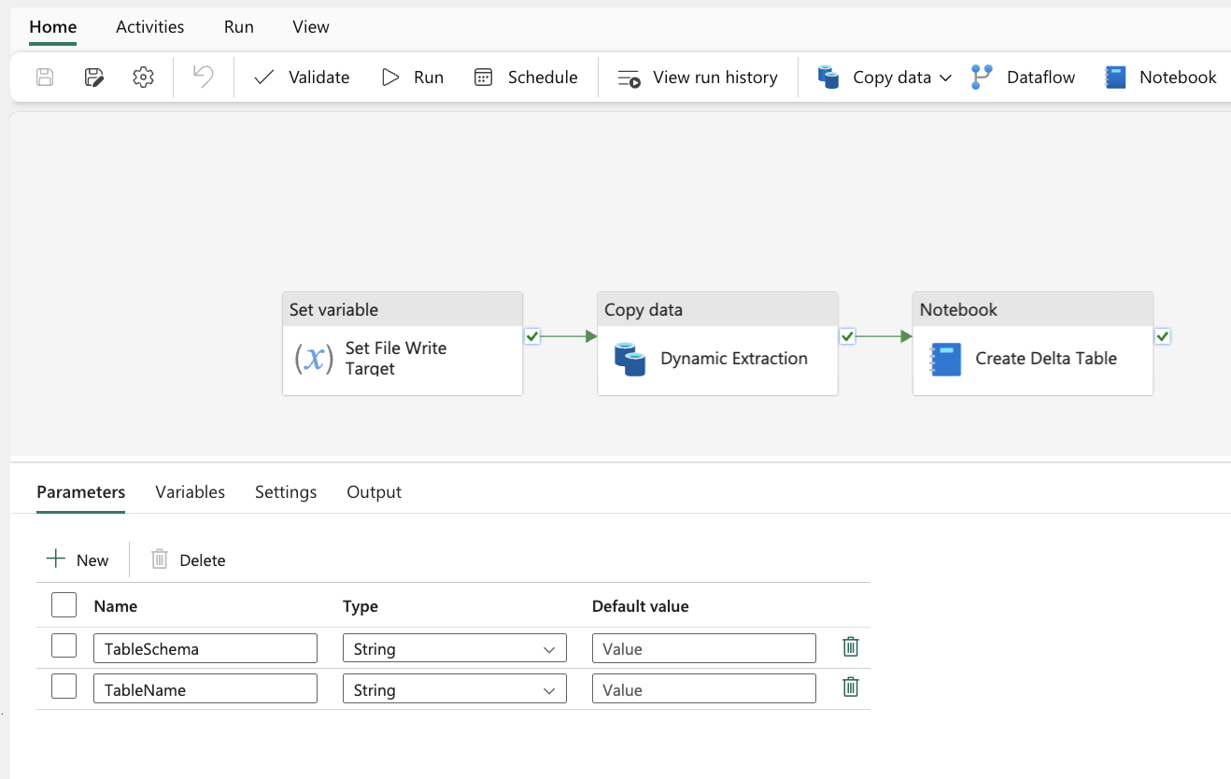
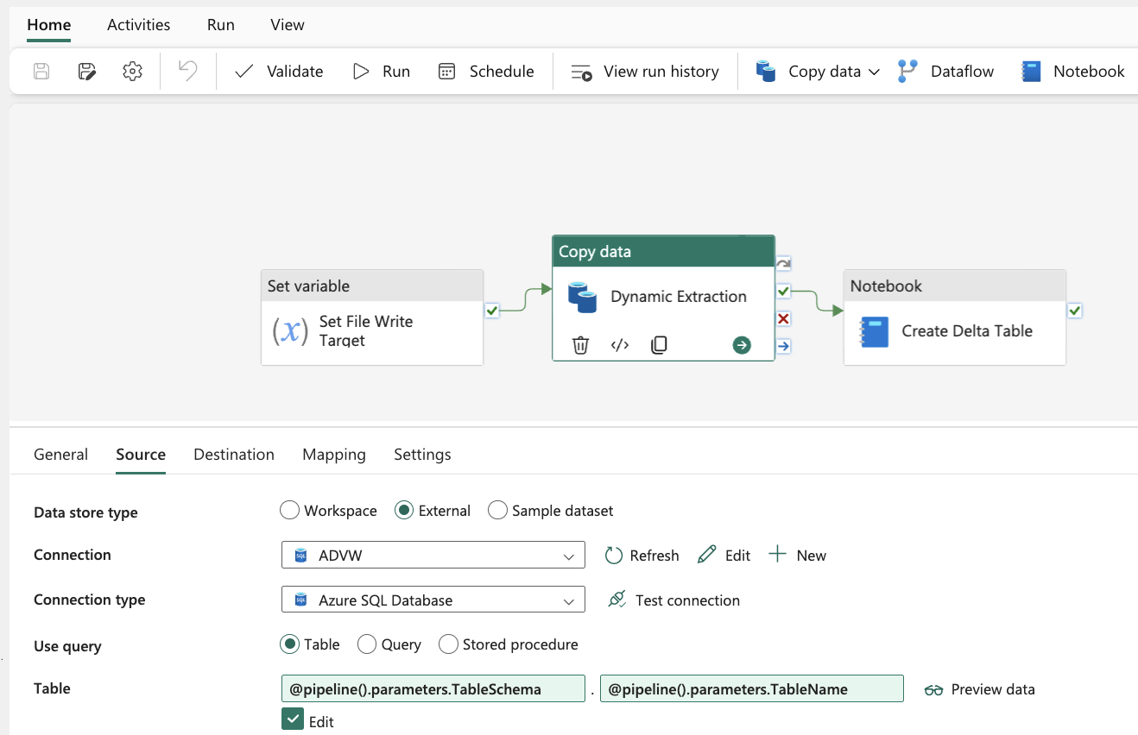
PIPELINE PARAMETERIZATION
Parameters allow developers to dynamically provide specific values for a pipeline run
Source and destination objects, folders, and files
Can be combined with other activities, like ForEach loops, to optimize dynamic ingestion patterns
Enhances pipeline reusability

Slide 46
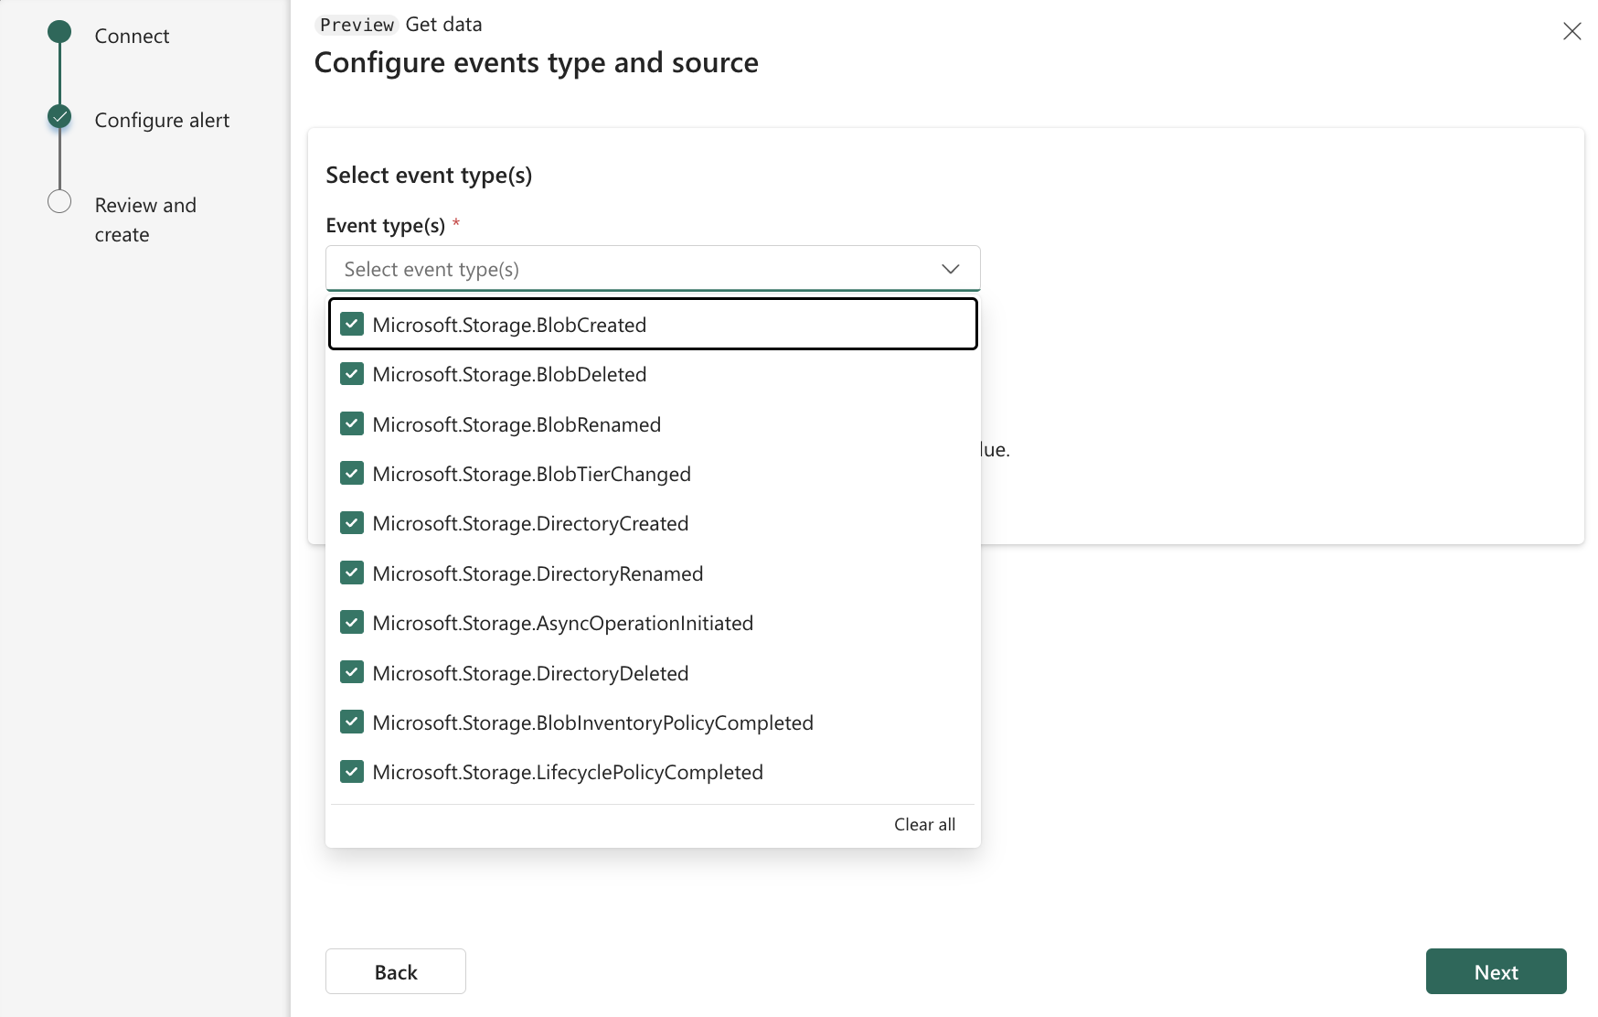
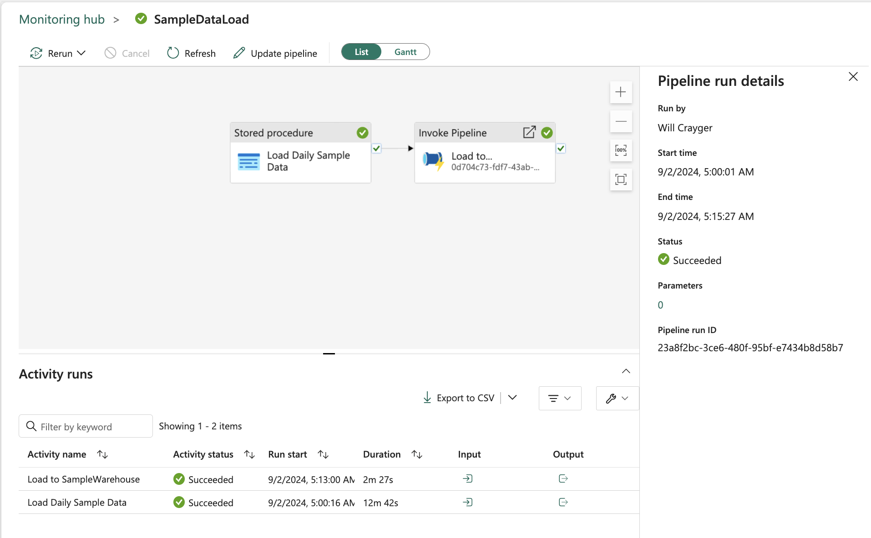
PIPELINE EXECUTION AND MONITORING
Pipelines can be executed on-demand, scheduled, or triggered based on a storage blob event
Pipeline run history can be viewed in the monitoring hub or the Run History pipeline tab
Run id’s captures every pipeline execution and are useful for reviewing run details about an execution
Execution history can be viewed as an activity list or a Gantt chart

Slide 47
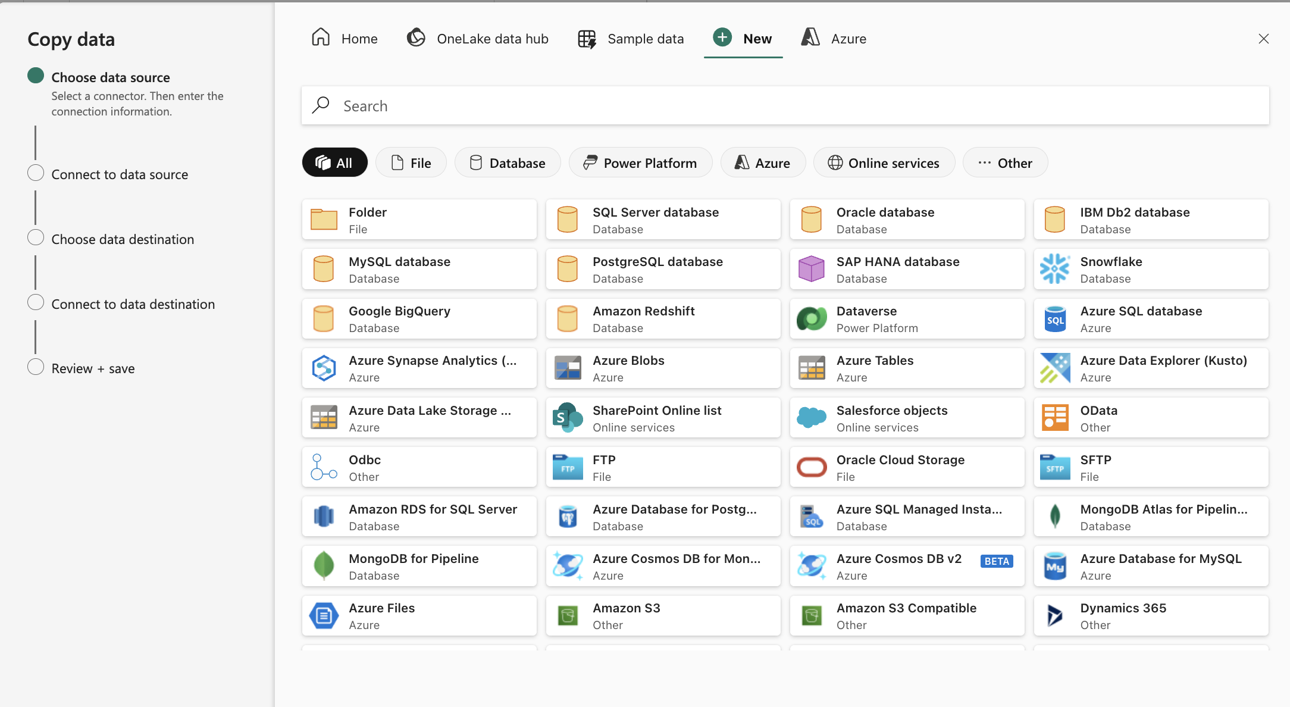
COPY DATA ASSISTANT
A graphical tool that guides users through configuring the data source and destination
Can pick from existing source in OneLake Data Hub or select from a broad range of source connections
Additional connectors are released each month

Slide 48
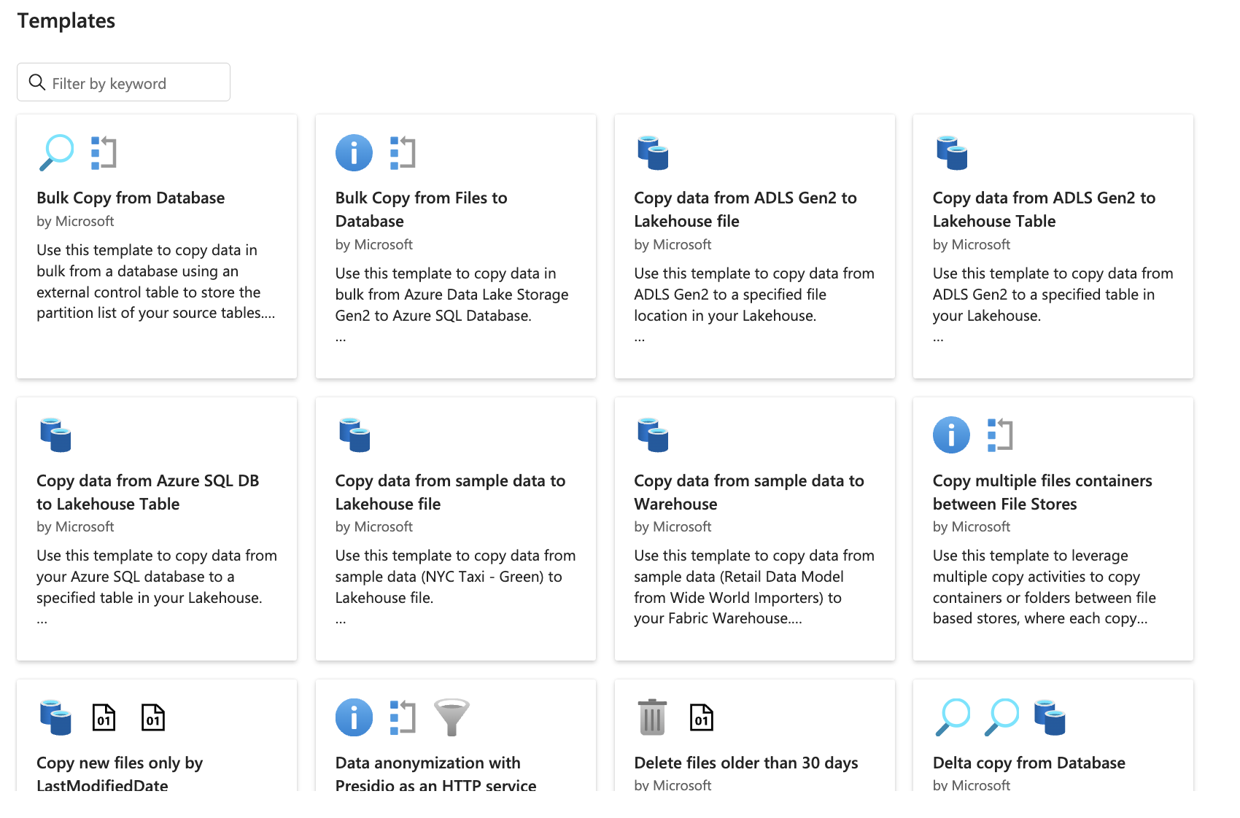
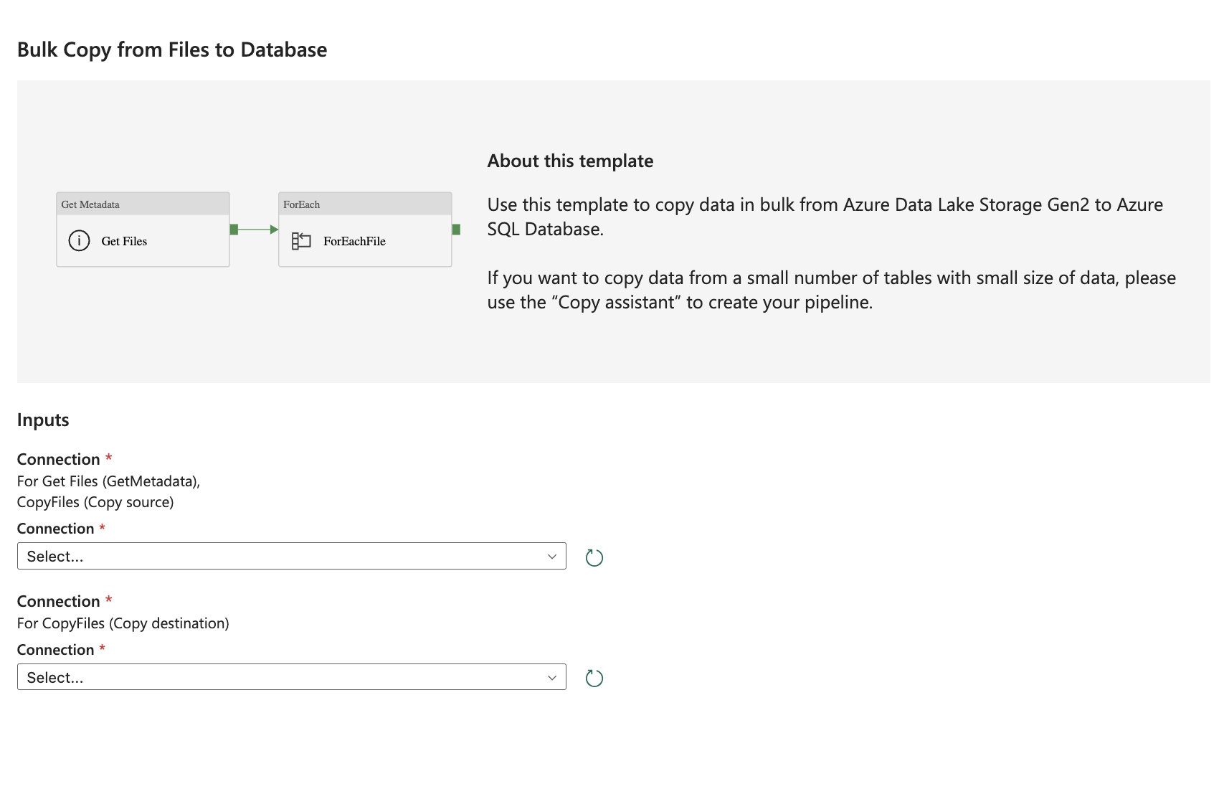
USING PIPELINE TEMPLATES
Fabric offers predefined pipeline templates for common scenarios
Templates can be used as a starting point and customized as needed
Navigating creation using a template constructs the pipeline canvas for you to simplify development

Slide 49
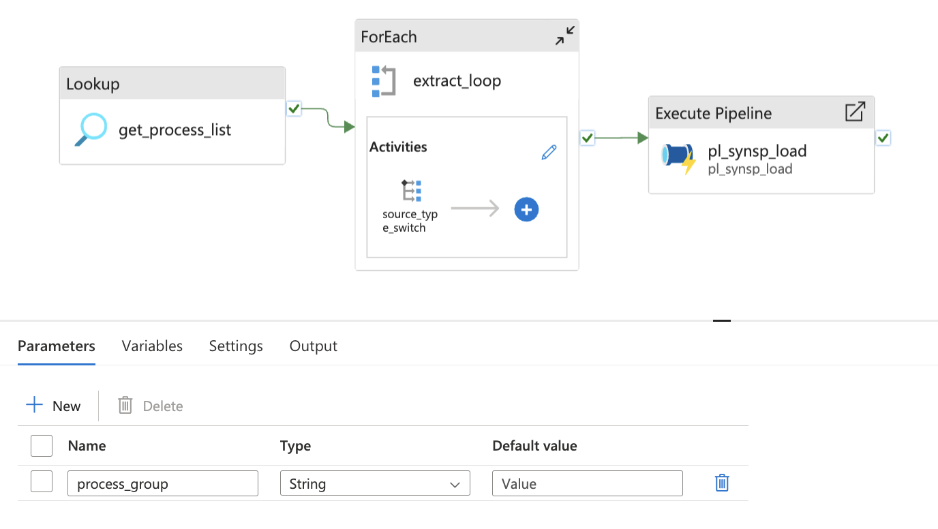
CUSTOM COPY PATTERNS
Copy task can be combined with other activities to create repeatable and flexible data ingestion patterns
Example:
Lookup activity executes a query against configuration tables using a pipeline parameter to return a list of tables to process
List of tables is passed to a ForEach loop containing a switch statement for conditional execution of copy activities
Execute Pipeline activity passes the parameter to a pipeline containing another Lookup activity and a Notebook activity for transforming and loading data

Slide 50




GUIDED LEARNING LAB 3
Create a pipeline
Add a simple copy activity
Move data from source to OneLake
Scheduling

Slide 51
INTRO TO APACHE SPARK IN MICROSOFT FABRIC

Slide 52



INTRO TO SPARK
Apache Spark is an open-source framework for large-scale data processing.
It's popular for "big data" processing and is available in multiple platforms:
Azure HDInsight
Azure Synapse Analytics
Azure Databricks
Microsoft Fabric
Spark in Fabric is used for data ingestion, processing, and analysis with lakehouse at the core.

Slide 53
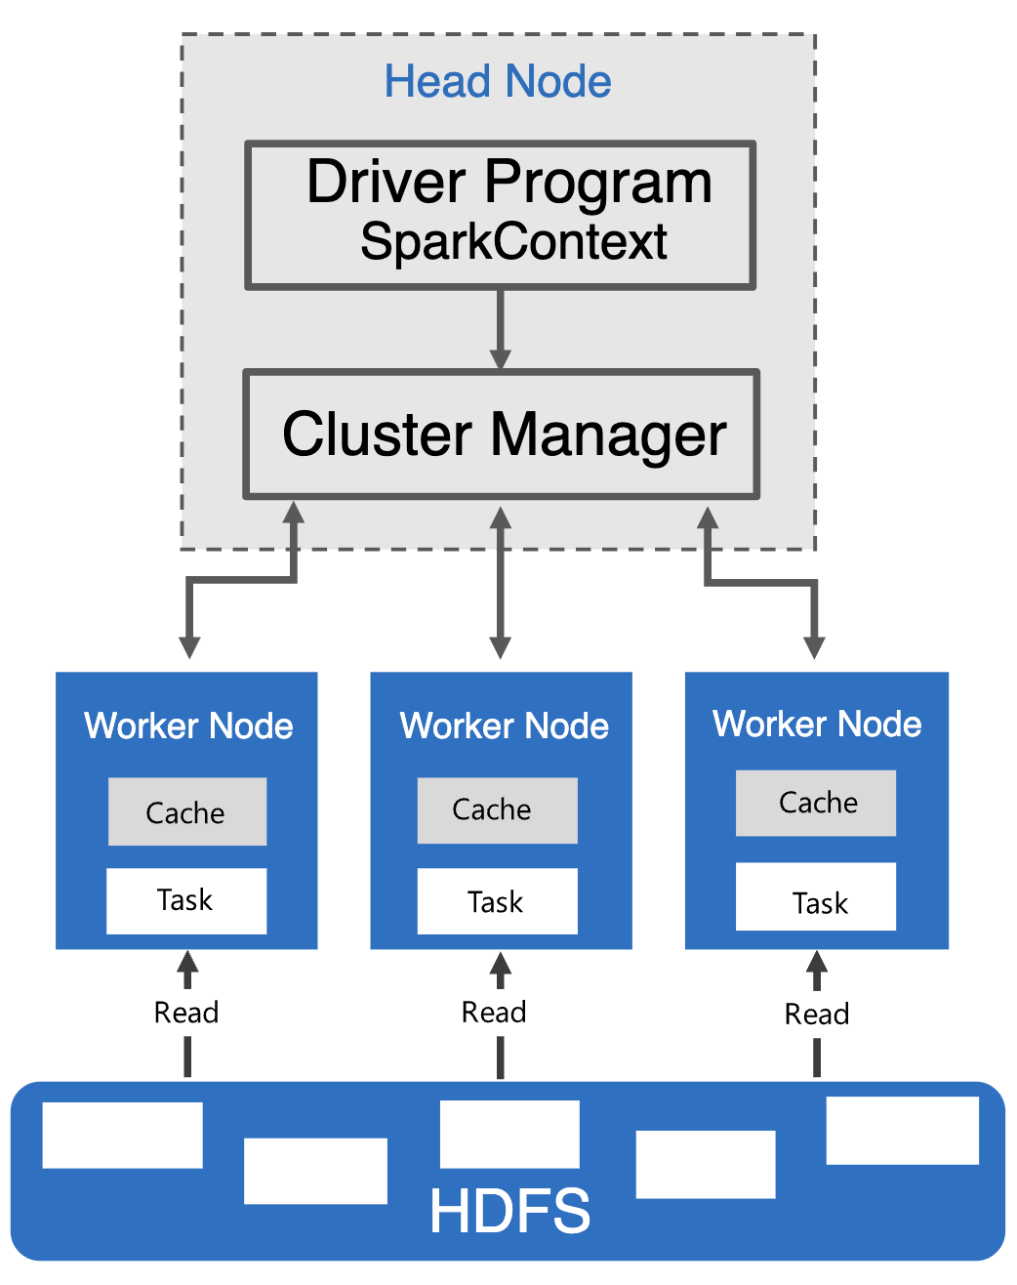
BASICS OF APACHE SPARK
Distributed data processing framework that facilitates large-scale data analytics by coordinating tasks across multiple processing nodes
Uses a "divide and conquer" strategy by spreading the workload across multiple machines
Distribution of tasks and results aggregation is managed by Spark
Distribution process:
User submits a data processing job using code
This code initiates a driver program
Driver program uses SparkContext to oversee the distribution of tasks within the Spark cluster

Slide 54
SPARK LAZY EVALUATION
Deferred Execution:
Spark operations are not immediately executed and are instead are added to a DAG (Directed Acyclic Graph) of transformations
The actual execution only happens when specific actions are triggered (e.g., collect(), count(), write())
Efficiency Benefits:
Allows Spark to optimize the execution plan based on the entire pipeline of transformations rather than executing each transformation step by step
Minimizes redundant computations and reduces I/O operations by pipelining transformations.

Slide 55
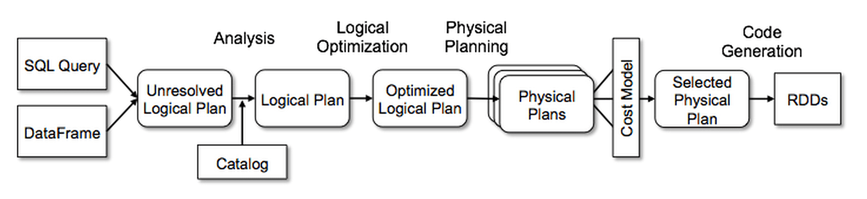
SPARK SQL CATALYST OPTIMIZER
Analysis:
Uses the Catalog to build a logical plan by looking up table and column name references
Applies rules to map attributes to their input, assign unique IDs to attributes, and propagate or coerce data types
Logical Optimization:
Applies rule-based optimizations such as constant folding, predicate pushdown, projection pruning, null propagation, and Boolean expression simplification
Performs cost-based optimization by generating and evaluating multiple plans.

Slide 56
SPARK SQL CATALYST OPTIMIZER
Physical Optimization:
Generates physical plans and selects the best using a cost-based model by choosing the optimal join algorithm
Applies rule-based optimizations, like pipelining projections and filters into a single operation, and supports pushdown to data sources.
Code Generation:
Uses quasiquotes in Scala to generate and compile Java bytecode for execution
Transforms SQL expressions into abstract syntax trees (ASTs) for faster, CPU-bound in-memory processing

Slide 57
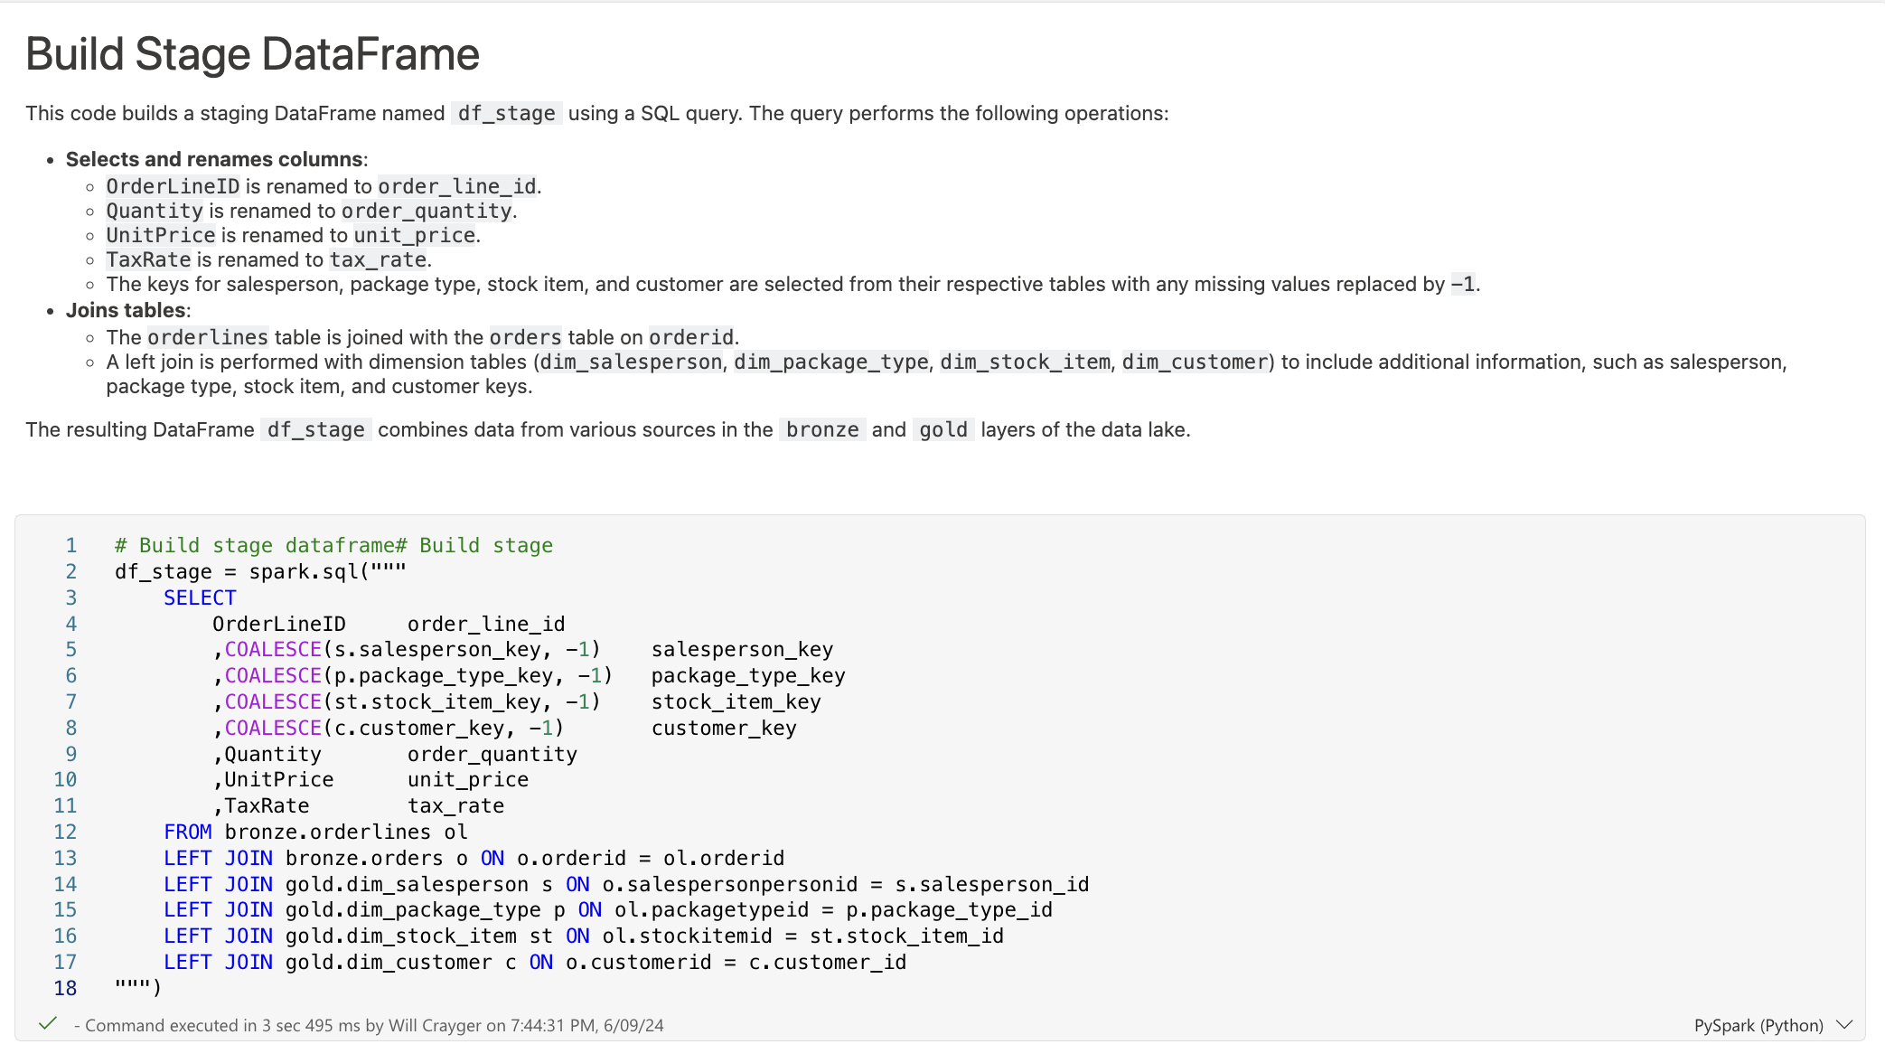
SPARK NOTEBOOKS
Ideal for big data workloads and analysis using Spark
Allows for a mix of text, images, and code in multiple languages
Consists of markdown cells for documenting and executable code cells
Code can be executed interactively with immediate results

Slide 58
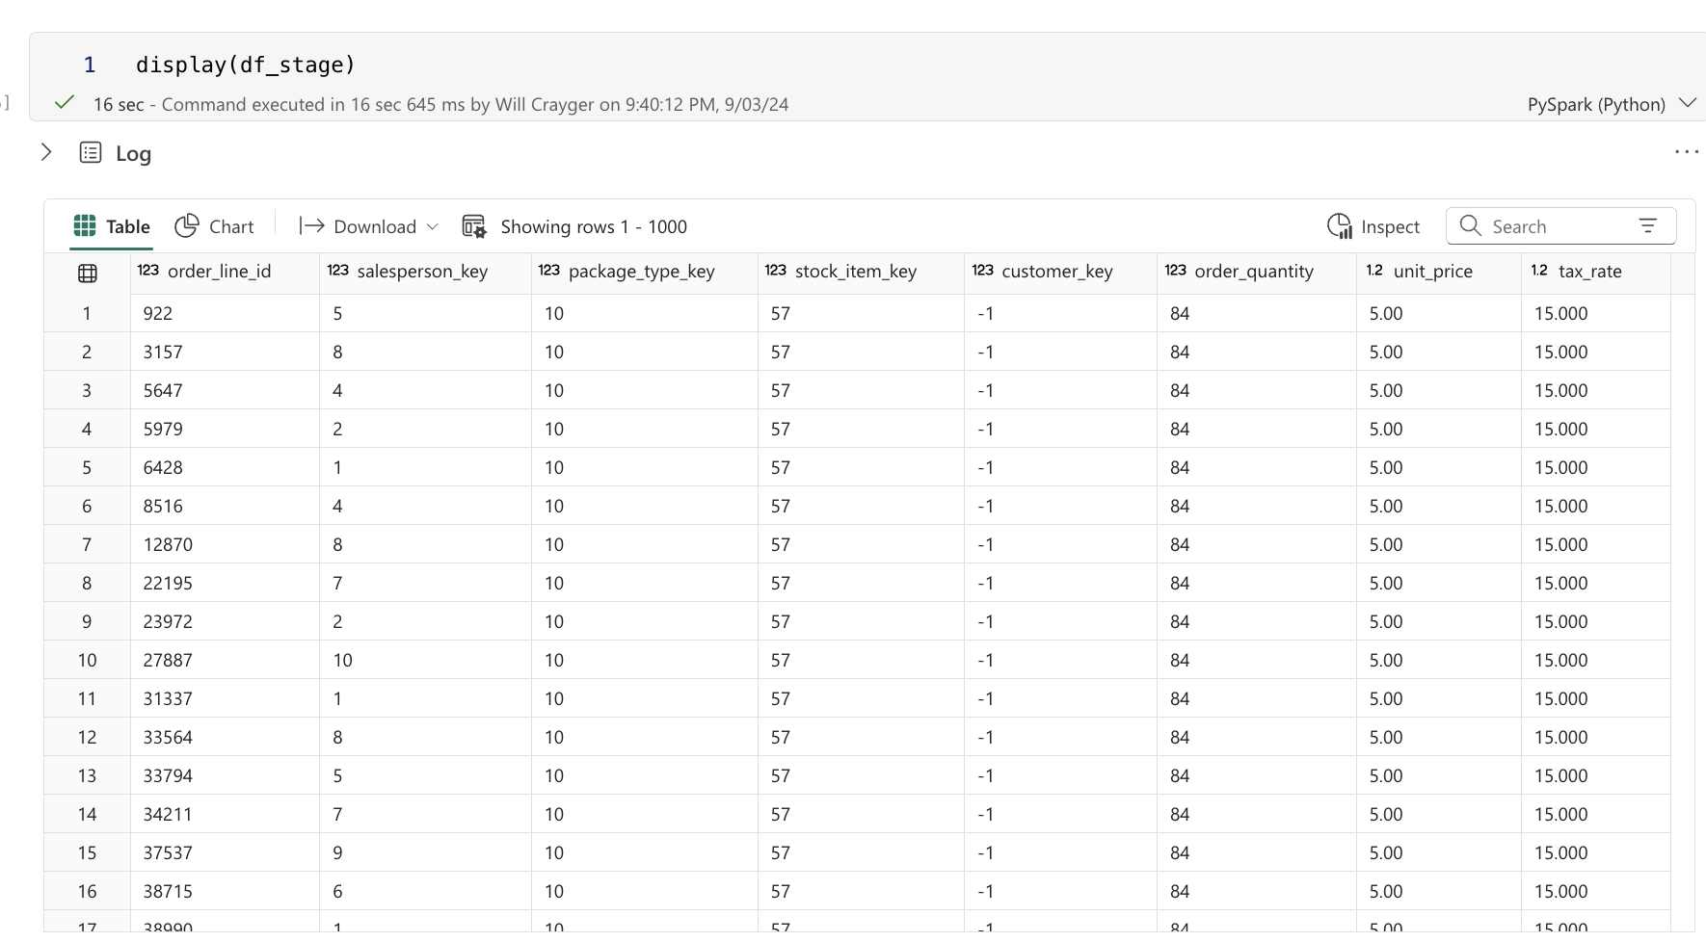
SPARK DATA STRUCTURES
Resilient Distributed Dataset (RDD):
Fault-tolerant and parallelizable collection of elements providing low-level operations and control over data processing
Generally used with unstructured data
DataFrame:
Provides a schema-based view of data, similar to tables in relational databases
Leverage Sparks Catalyst optimizer which automatically optimizes queries based on structure and operations performed

Slide 59
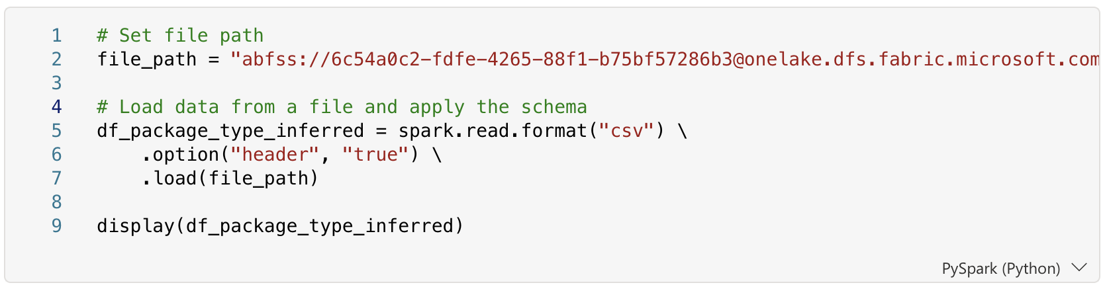
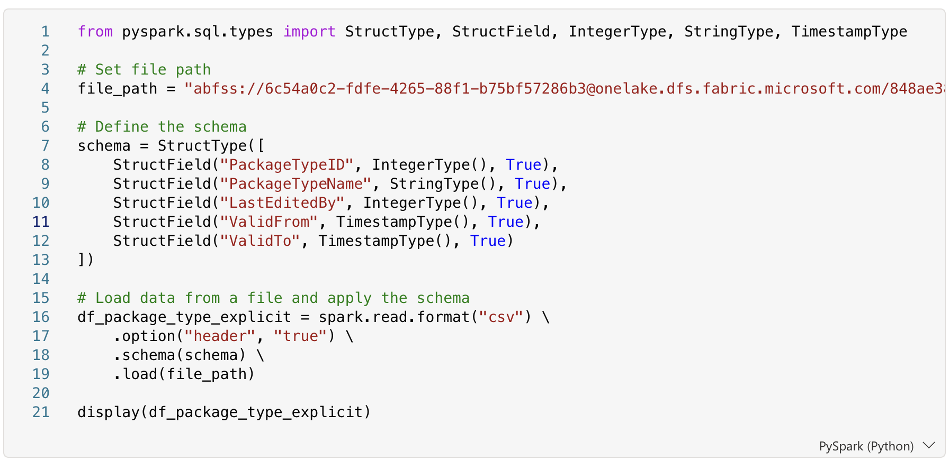
SCHEMA DEFINITION
Inferred:
Automatic Detection: Spark automatically determines data types based on the data
Simplified by Headers: Easier when the first row contains column names
Explicit:
User-Defined: Required when column names or types aren't clear in the data
Performance Boost: Enhances performance by reducing the need for Spark to infer data types

Slide 60
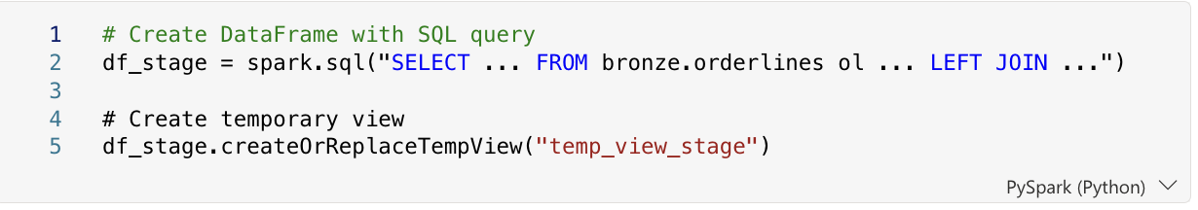
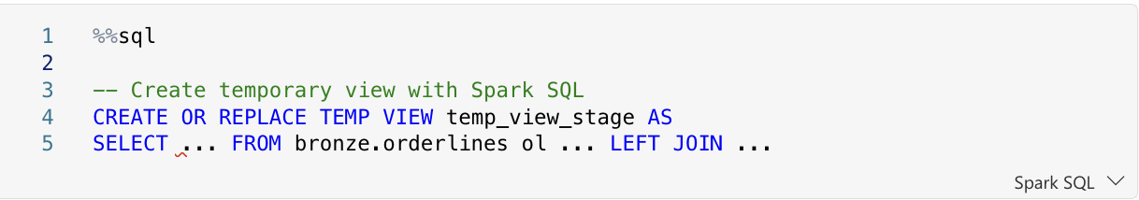
SPARK CATALOG OBJECTS - TEMPORARY VIEW
Used to make DataFrame data available for querying with SQL
Created within a session and deleted when the session ends
Data is not persisted; no additional storage used
Suitable for quick, ad-hoc analysis and temporary processing

Slide 61
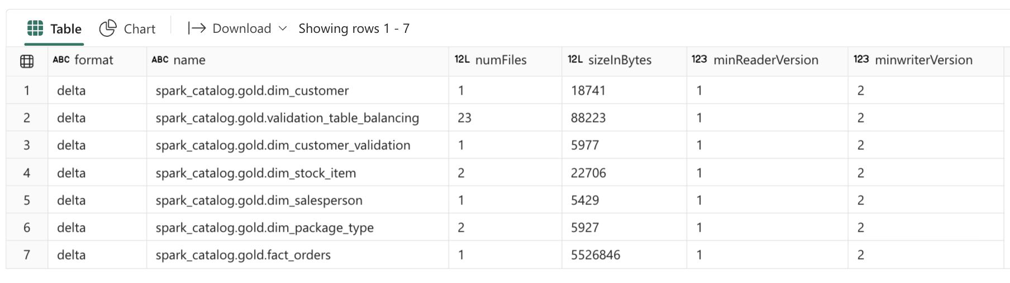
SPARK CATALOG OBJECTS - TABLE
Persistent storage of data in a defined location
Metadata stored in the catalog, describing data structure
Can be queried using Spark SQL across sessions
Delta tables support:
ACID transactions for data integrity
Data versioning and time travel for historical queries
Streaming support for real-time processing

Slide 62
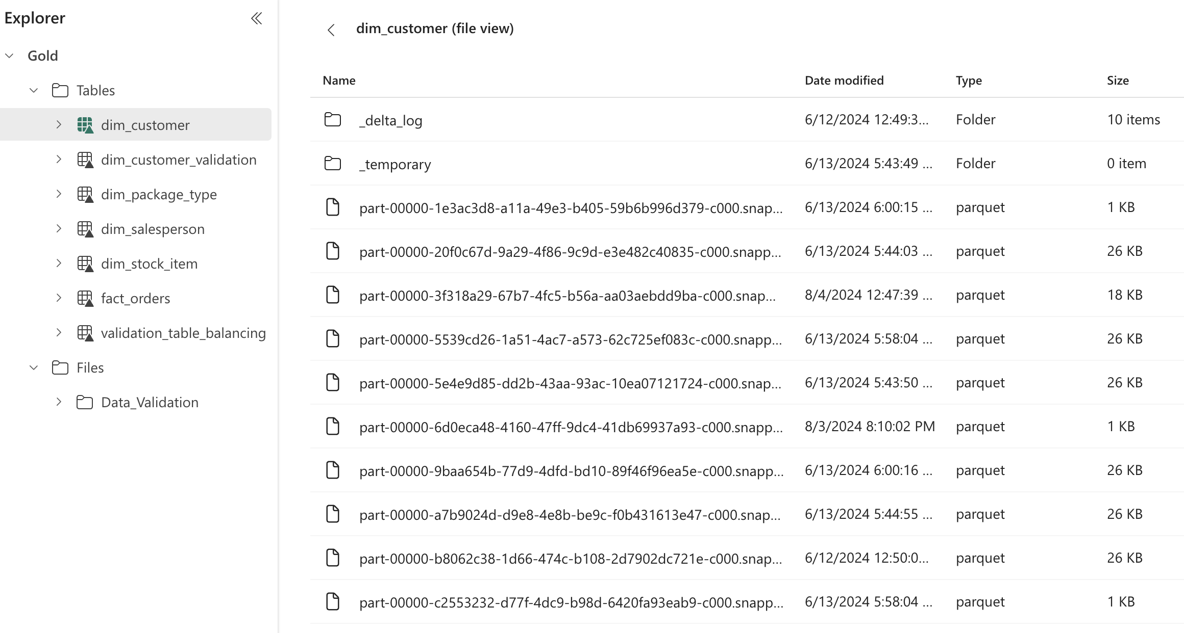
DELTA LAKE TABLES IN FABRIC
Denoted by a triangular Delta (▴) icon
Tables are schema abstractions over data files stored in the Delta format
Each table consists of a series of parquet data files and a _delta_Log folder logging transaction details

Slide 63
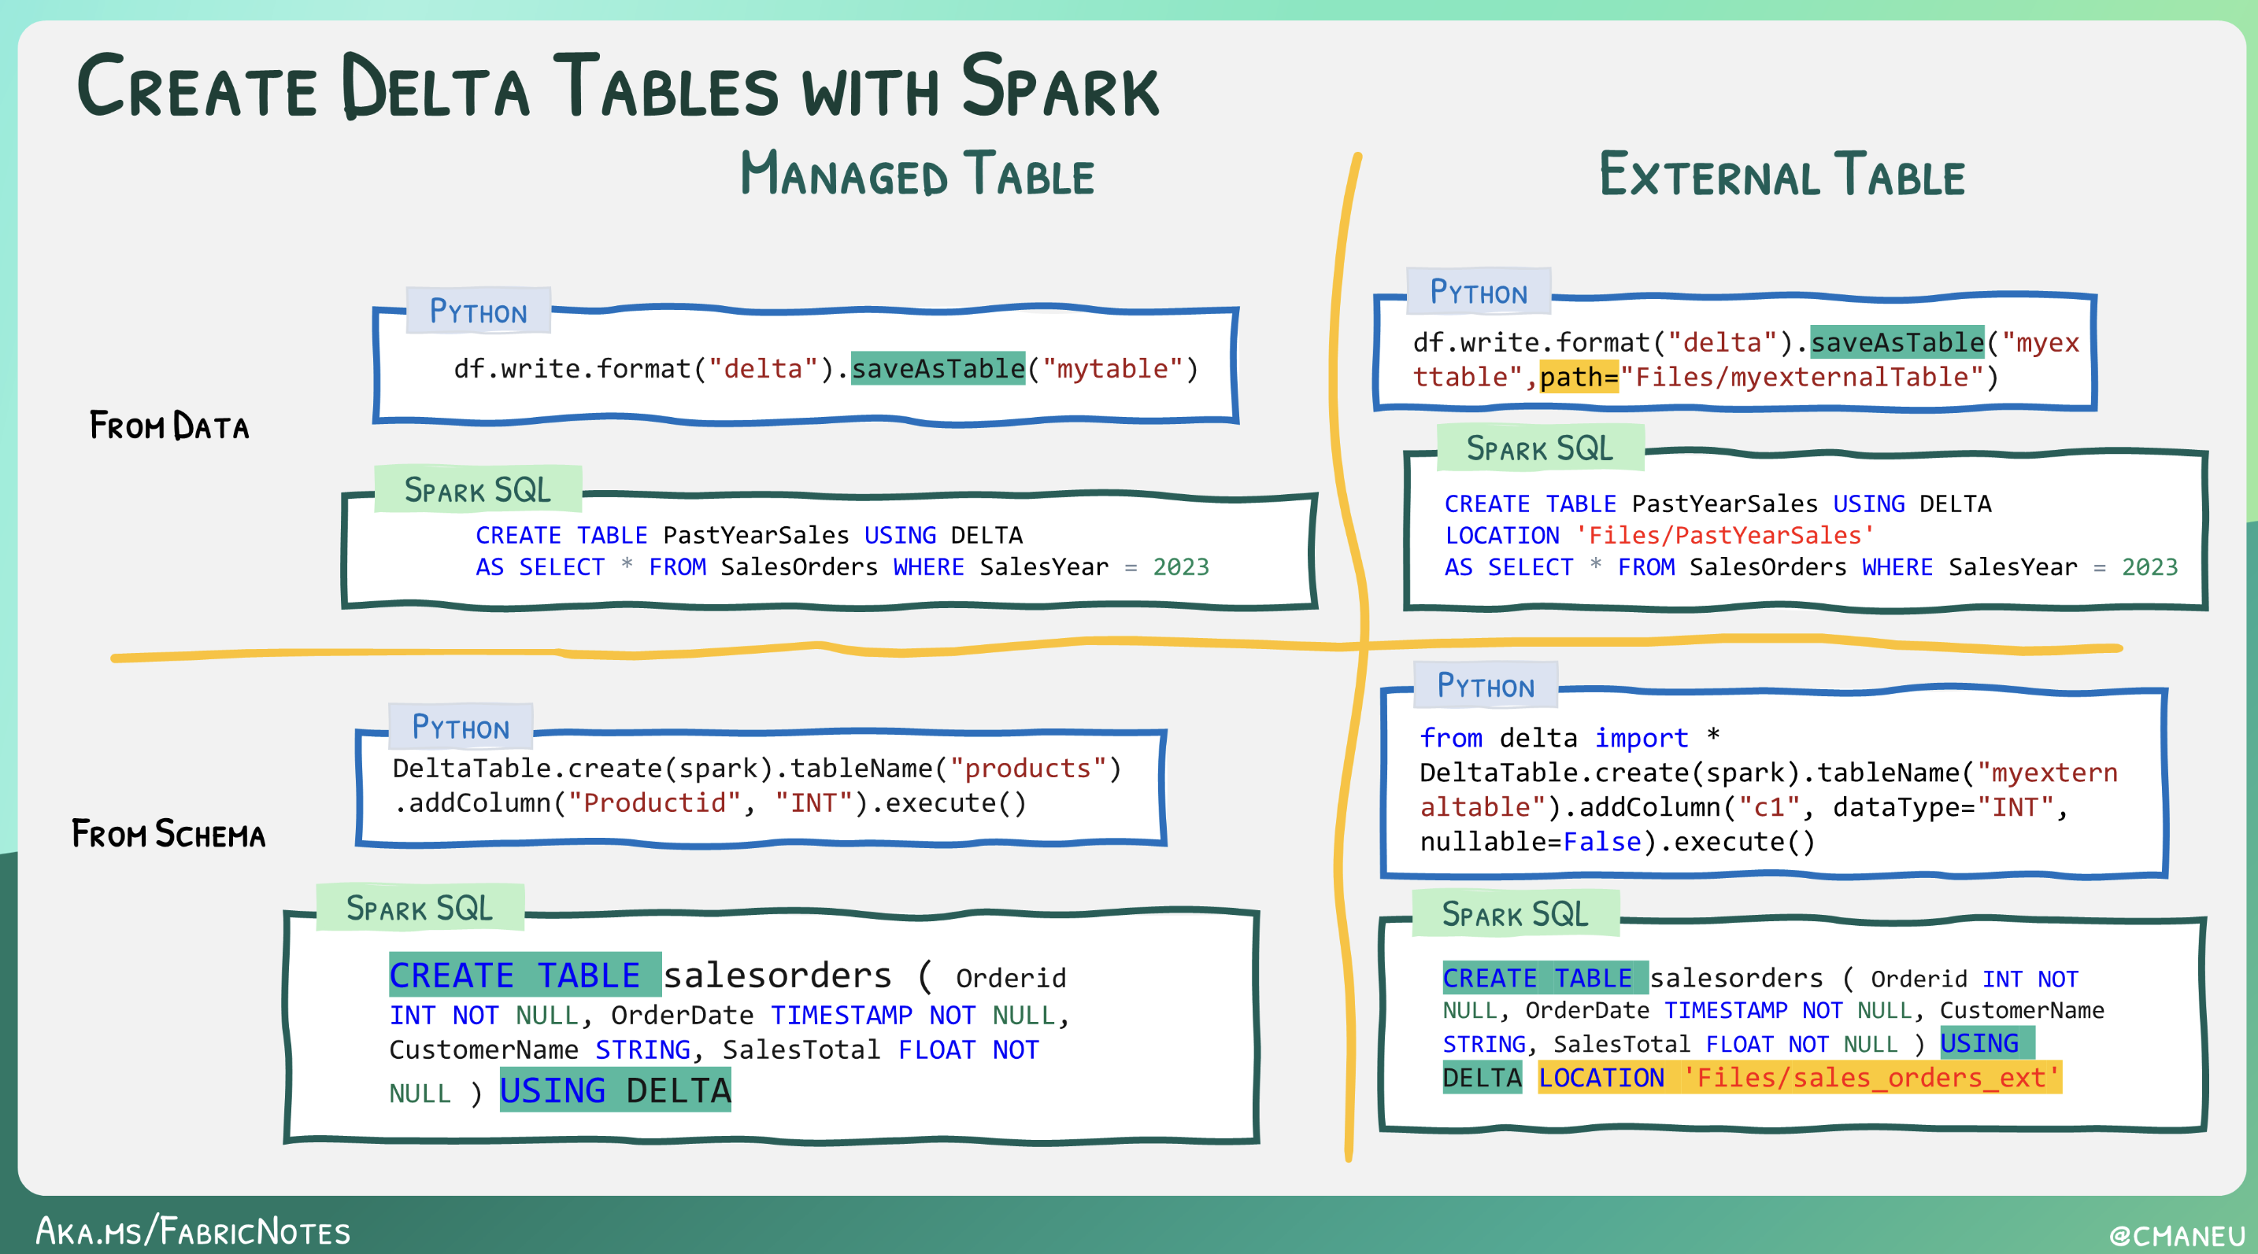
MANAGED OR EXTERNAL TABLES
Managed Tables:
Both the table definition in the metastore and the underlying data files are managed by the Spark runtime
Underlying files from the Tables storage location will be deleted with the table
External Tables:
Relational table definition in the metastore is mapped to an alternate file storage location
Deleting an external table from the lakehouse metastore does not delete the associated data files

Slide 64



GUIDED LEARNING LAB 4
Import Notebook using the Data Engineering Experience
Build “silver” Lakehouse
Using views to transform data
Work through transformations notebook

Slide 65
WORKING WITH FABRIC WAREHOUSE

Slide 66
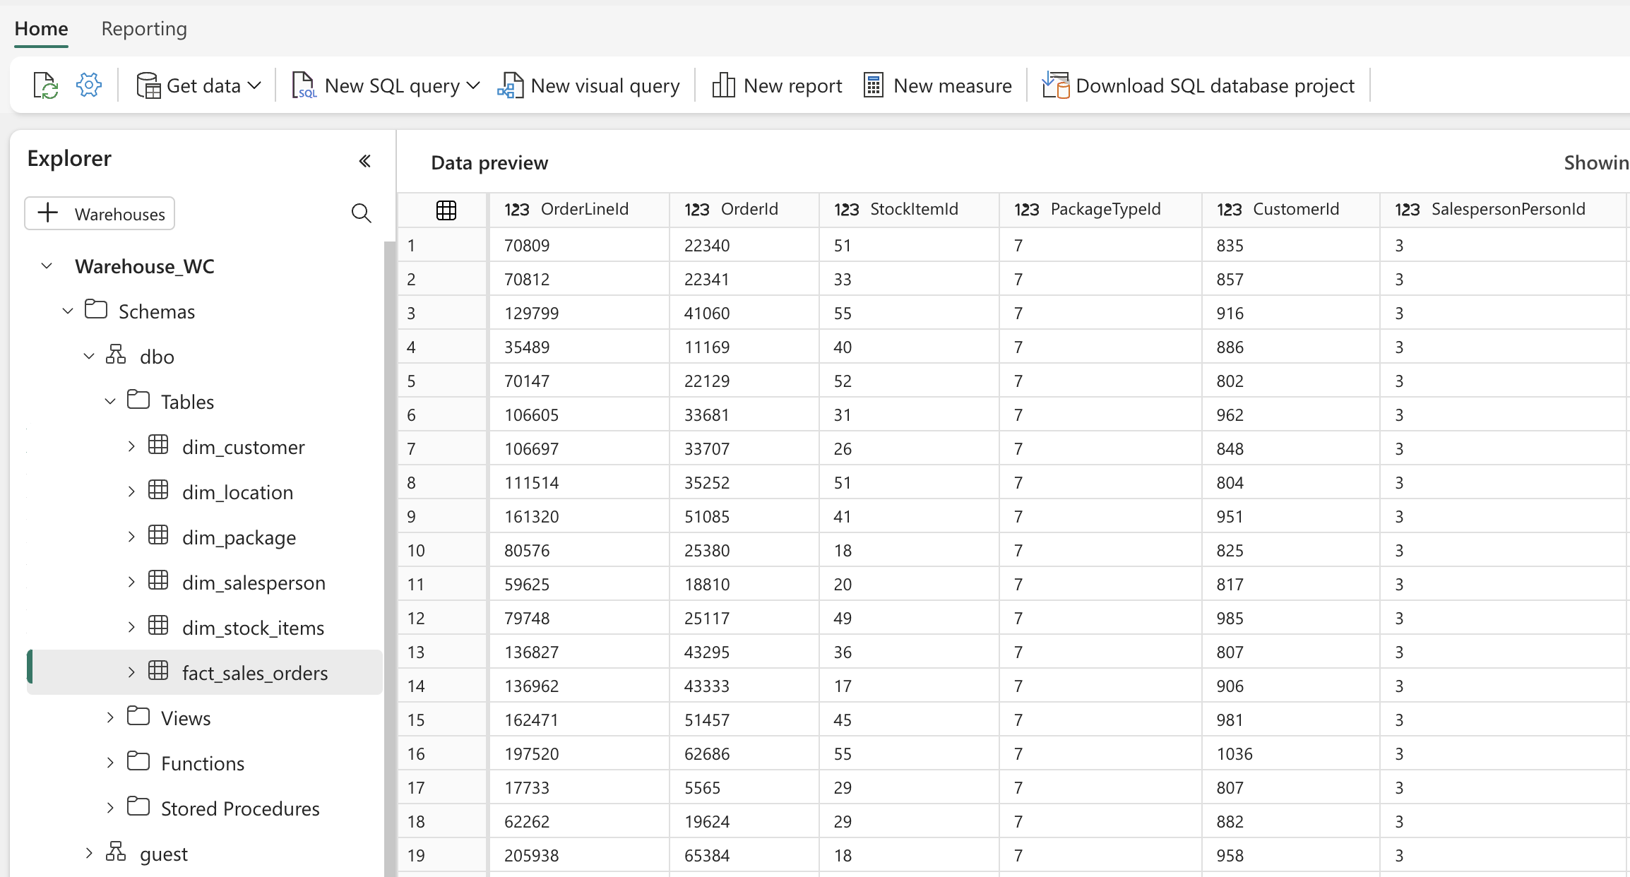
WORKING WITH FABRIC WAREHOUSE
Fabric Warehouse, like the Lakehouse, uses a lake-centric architecture leveraging delta storage format
Unlike the Lakehouse, Warehouse includes full SQL semantics allowing for insert, update, and delete operations
Accessible from common tools like SSMS and Azure Data Studio
Ideal for working with structured data workloads

Slide 67
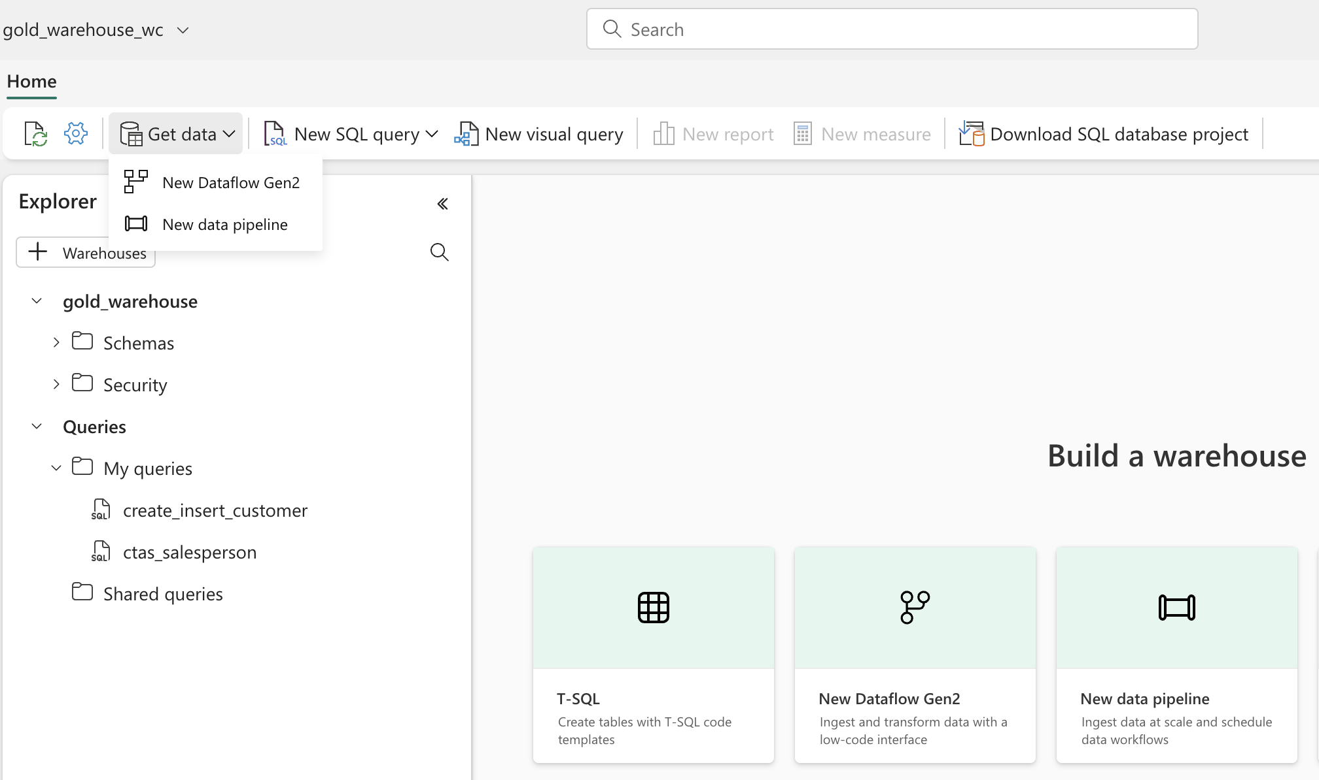
WAREHOUSE FEATURES AND INTEGRATION
Both data pipeline and dataflow gen2 can write directly to Warehouse tables
Warehouse database project support for managing source code
Multi-table transactional support

Slide 68
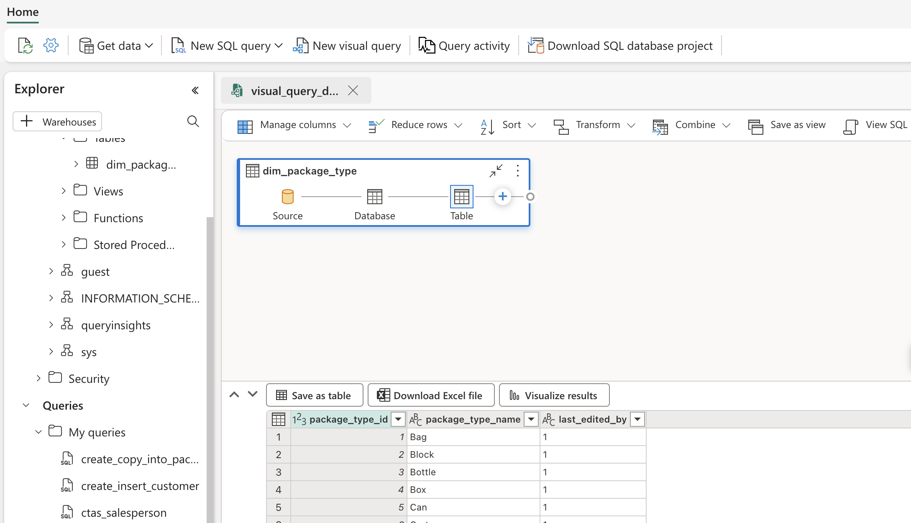
WAREHOUSE FEATURES AND INTEGRATION
Allows for the creation of tables, views, and stored procedures
Provides features like intellisense, code completion, and syntax highlighting
Supports query creation using the new visual query editor

Slide 69
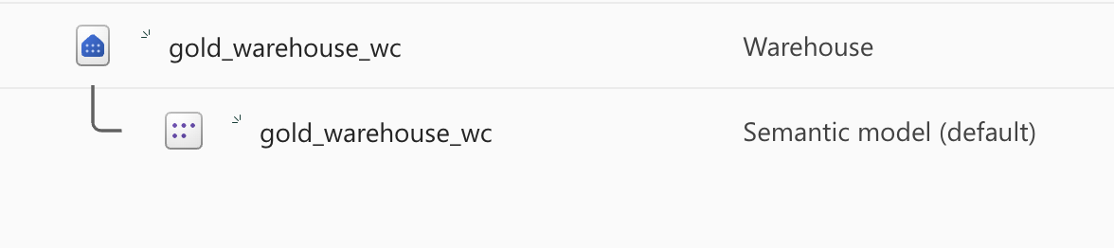
SETTING UP AND NAVIGATING THE WAREHOUSE
Each Warehouse in a Fabric-enabled workspace consists of two main elements:
Warehouse: Storage and metadata section used to engage tables
Semantic Model (default): Auto-generated data model derived from the tables in the Lakehouse

Slide 70
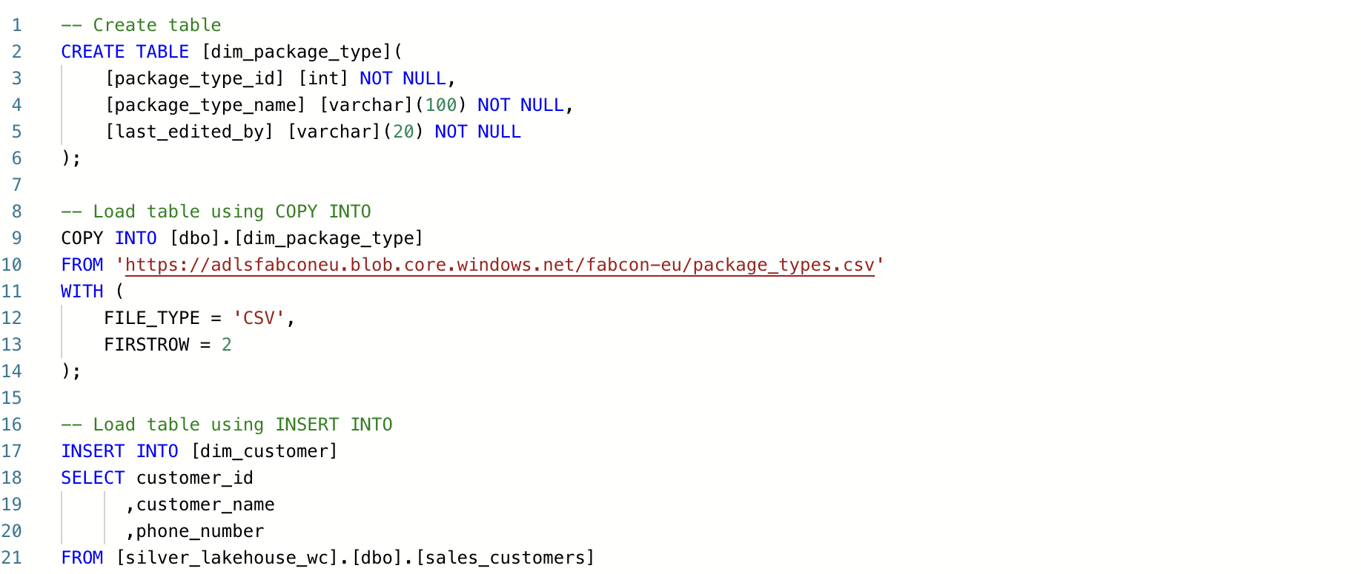
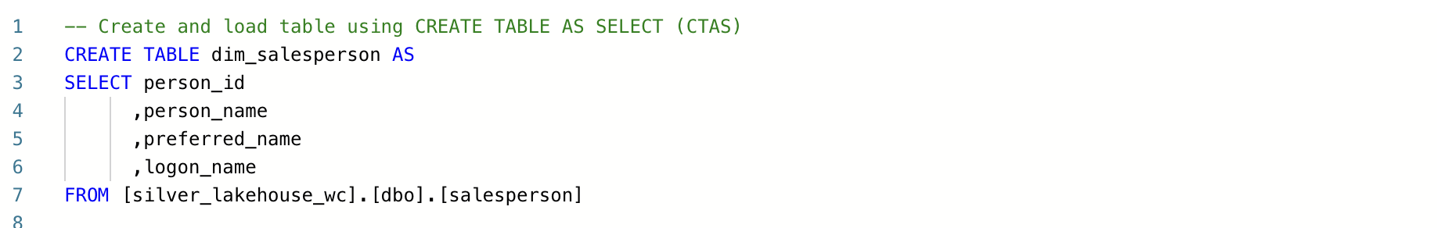
TABLE CREATION AND LOADING
CREATE TABLE and INSERT as independent operations
CREATE TABLE and COPY INTO as independent operations
CREATE TABLE AS SELECT to combine the table creation and loading to a single operation

Slide 71



GUIDED LEARNING LAB 5
Create Fabric Warehouse
Review Warehouse Loading Patterns
Build Dimensional Model

Slide 72
ANALYZING DATA IN FABRIC WITH POWER BI

Slide 73

UNDERSTANDING SEMANTIC MODELS
A default semantic model is automatically created whenever a Data Warehouse or Lakehouse is provisioned
Default semantic models are automatically synchronized with the Warehouse or Lakehouse
Users can create custom datasets tailored to their requirements

Slide 74

SEMANTIC MODEL CONNECTIVITY
There are three primary connectivity options when creating a new semantic model:
Import: Data is cached in the semantic model meaning there’s no need to translate queries from DAX/MDX to the source
Direct Query: Data is queried from the source at report consumption. Performance is often slow, but data is considered ”live”
Direct Lake: Data is read directly from OneLake delta tables without requiring an import or the need to query from the source directly

Slide 75
DIRECT LAKE CONSIDERATIONS
Semantic Models must be created directly from the Fabric UI, desktop development is not supported
Direct Lake connections may “Fallback” to Direct Query connections
Only semantic model tables originating from a Fabric Lakehouse or Warehouse are supported
Calculated tables and columns aren’t supported

Slide 76

PREPARING DATA FOR ANALYSIS AND REPORTING
Semantic models allow you to define:
Relationships between tables
Rules for data aggregation and summarization
Calculations or measures
Serve as the foundation for Power BI report
generation

Slide 77

DATA AGGREGATION USING MEASURES
Calculated measures represent the metrics to be analyzed
Measures are defined using the Data Analysis Expressions (DAX) formula language
Can be created from the Fabric UI or using other tools connected to the XMLA endpoint such as Tabular Editor

Slide 78



GUIDED LEARNING LAB 6
Create custom semantic model
Add a measure for explicit aggregation
Create a custom Power BI report using DirectLake
Create an auto-generated report

Slide 79





aka.ms/FabricCommunity Connect with community members, ask questions, and learn more about Fabric
Get Involved
in the Fabric
Community
aka.ms/FabricUserGroups
Find a user group that matches your interests in your area or online
aka.ms/SuperUsers
Spread your Fabric knowledge, insights, and best practices with others
aka.ms/MVP Technology experts that share their knowledge and passion with the community
Notes:
Main Content Slide: Title + Dual Visual-Data
Use this slide for inserting two types of visual-data into the Main Content of the presentation.
Font-size can be altered to allow the content to fit the slide correctly.
The Title Text Box can be deleted if not required.

Slide 80

FREE Microsoft Fabric
Certification Exam
Are you ready to get Fabric certified by the end of October?
Claim your 100% discount voucher for Exam DP-600: Fabric Analytics Engineer.
Come find us in the Community Lounge under the Get Certified banner to learn more!
aka.ms/FabCon24/IAmReady
Notes:
Main Content Slide: Title + Dual Visual-Data
Use this slide for inserting two types of visual-data into the Main Content of the presentation.
Font-size can be altered to allow the content to fit the slide correctly.
The Title Text Box can be deleted if not required.

Slide 81
Notes:
End Slide: Rate This Session
Final Slide on all presentations.
The speaker should not edit, move or delete this slide.

